Slide 1
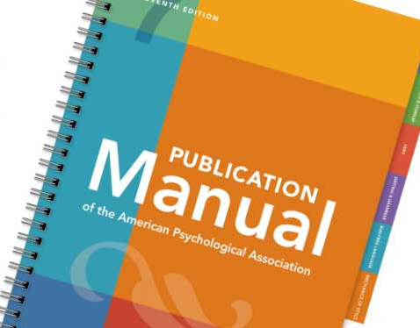

APA Style Upgrade:
Writing with the 7th Edition of the APA Publication Manual
Presented by
NWGC Doctoral Organization for the Collaboration of Scholars (DOCS)
Dr. Kendahl Shortway, Dept. of Advanced Studies in Psychology

Slide 2
Welcome to our inaugural workshop!
Doctoral Organization for the Collaboration of Scholars (DOCS)
I do not represent the American Psychological Association (APA) with this presentation
When will you be expected to use the 7th edition?
Please complete the survey at the conclusion of the workshop!

Slide 3
Workshop Overview
What is APA style?
Purposes and advantages of writing in APA style
Major changes from the 6th to 7th editions of the Publication Manual
Guidelines specific to student papers
Correcting common APA style errors
Writing activity and discussion

Slide 4
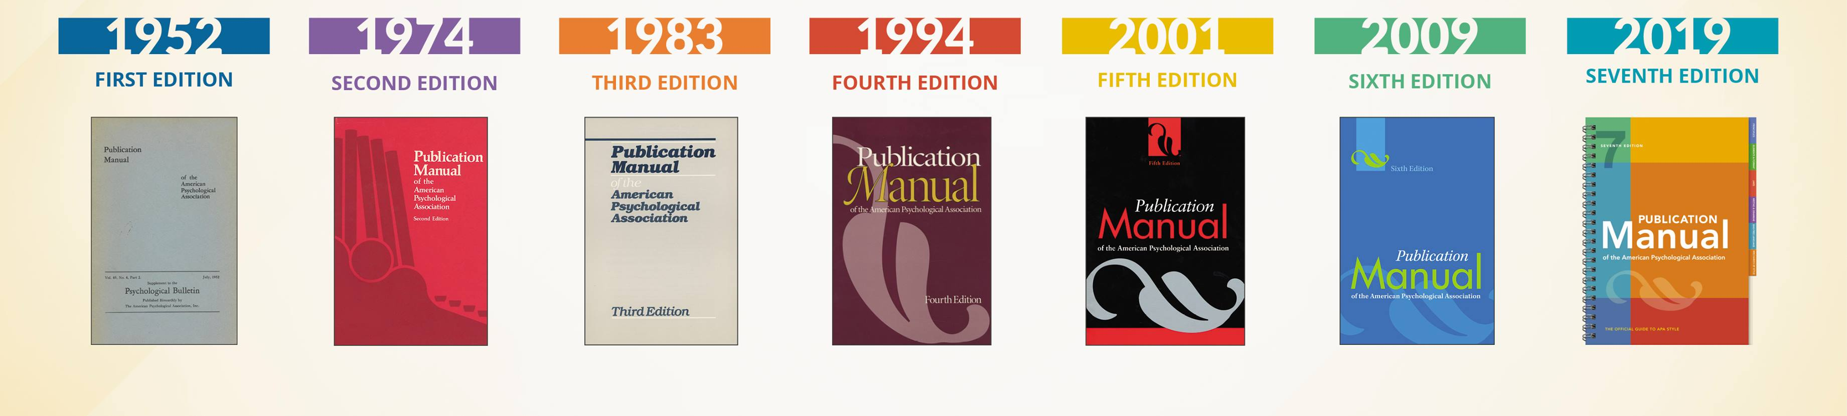
What is APA Style?
The Publication Manual is published by the APA in collaboration and consultation with scholars and professionals across many disciplines
APA style is commonly used in the social and behavioral sciences for student papers and scientific journals
Image from APA Books (2019)

Slide 5
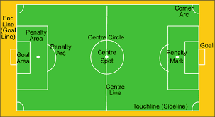

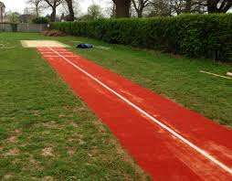
Imagine…
Writing without a shared style would be like sports without any rules! An athlete could be determined, strong, and coordinated…but without regulation of equipment, officials, or rules, how could athletes demonstrate their skills and abilities? How would spectators interpret what was happening? How could strangers play with each other? What would athletes do?

Slide 6
Purpose and Advantages of APA Style
A shared way of communicating allows us to read and write efficiently
  We know where to look to find information
  Students have a structure to follow
  Scholars can share knowledge across countries and cultures
Can be frustrating to learn, but ultimately saves time and confusion
Guidelines and rules enable consistency, accessibility, and ethical writing
Like all skills, writing in APA style entails practice and learning

Slide 7
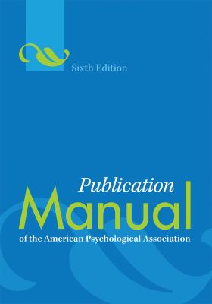
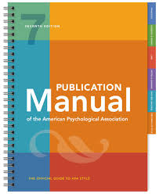
Major Changes from the 6th to 7th Edition

Slide 8
Noticeable Changes in Appearance
Fonts:
11-point Calibri
11-point Arial
10-point Lucida Sans Unicode
12-point Times New Roman
11-point Georgia
10-point Computer Modern
Ask your course instructor if there is a preferred front. And, fonts are different for figure images, computer codes, and footnotes.
1
Title of Paper
Student Name
APA 101: APA Style
Dr. Kendahl M. Shortway
January 28, 2020
What are the changes to the student title page format?
TIP!

Slide 9
Changes to Headings
No heading for the introduction (it’s implied), so start with level 2 headings when needed in the introduction (paper title is level 1)
Level | Format
1 | Centered, Bold, Title Case Heading
2 | Flush Left, Bold, Title Case Heading
3 | Flush Left, Bold Italic, Title Case Heading
4 | Indented, Bold, Title Case Heading, Ending with a Period. Start
5 | Indented, Bold Italic, Title Case Heading, Ending with a Period. Start

Slide 10

Changes to Citations
Citing works with multiple authors:
  Two authors: include both every time (Inoa & Giordano, 2020)
  Two+ authors: only the first author every time (Shortway et al., 2020)
  But, if there are multiple authors in the same references, include as many authors as needed to avoid ambiguity:
    Shortway, Giordano, Kitzinger, et al. (2020)
    Shortway, Giordano, Webber, et al. (2020)
    Note that in these examples, “et al.” cannot refer to only one author, so that means there were multiple additional authors of each work
You can use a narrative citation: Shortway (2020)
Or a parenthetical citation: (Shortway, 2020)
And, avoid over-citation or under-citation!

Slide 11
Changes to Reference List Format
References with multiple authors:
  2-20 authors: provide surnames and initials for every author
  21+ authors: provide surnames and initials for the first 19 authors, then an ellipsis (no ampersand), and the final author’s name
Do not include the location of the publisher:
  Shortway, K., Giordano, G., & Kitzinger, R. H. (2020). Title of our book (2nd ed.). American Psychological Association.
No more “DOI:” label or “Retrieved from”– now presented as hyperlinks
If you use Google, EndNote, etc. to help format your references, double-check! We can do this better than robots can!
TIP!

Slide 12
Additional Changes
Use one space after the period at the end of a sentence
Use quotation marks around examples, not italics
More flexibility for lists (bulleted, lettered, or numbered)
Tables and figured can be embedded in the text (not just after reference list)
Tables and figures are now formatted consistently
Clearer guidance for annotated bibliographies
Did you know that you do not need to include a period after abbreviations for units of measurement or symbols? An exception is “in.” for inch!
Another tip: Only use “while” when referring to simultaneous events!
TIP!

Slide 13

Avoiding Bias Language
“Ask people from the groups about which you are writing to read and comment on your material or consult with self-advocacy groups to determine appropriate terminology. If you work directly with participants, ask them what terms they use to describe themselves” (APA, 2019, p. 131).
Describe with appropriate specificity and practice sensitivity with labels.
  “They” can now be used as a gender neutral pronoun!
See guidelines for terms used to describe:
  Age
  Disability
  Gender
  Participation in research
  Racial and ethnic identity
  Sexual orientation
  Socioeconomic status
  Intersectionality
Question yourself– why did you use a certain term or list groups in a certain order?

Slide 14

Additions to the Manual
Detailed guidance related to writing and publishing quantitative, qualitative, and mixed methods articles
There are samples of a professional paper and a student paper– note that there are different guidelines (e.g., the title page)
The section on journal article reporting standards (JARS) is significantly expanded
There are examples for every reference category
Invest in the manual! Available online for $20-35. There are also hard copies available to borrow through the library.

Slide 15

Did you know?
Anthropomorphism is the attribution of human characteristics to inanimate sources or animals
  “The study concluded…” “The researchers concluded…”
  “This paper will review…” “In this paper, I will review…”
Self-plagiarism occurs when an author presents their own previous work as original
It is not necessary to repeat the year in narrative citations in the same paragraph:
  Shortway (2020) found that apples and oranges could not be compared. Shortway suggested…
If you are citing information from the literature review or introduction of an article, it is likely that you are mistakenly citing a secondary source as if it was the primary source
There are guidelines for using abbreviations, including: introduce the abbreviation in the body of the text, and some phrases and terms do not need their abbreviations defined (e.g., IQ)
There are guidelines for capitalization, including: capitalize racial and ethnic groups (e.g., Black women) and do not capitalize diseases, disorders, therapies, treatments, theories, or models
You should update your CV/resume so that publications and presentations are in correct APA style!

Slide 16
Common APA Style Errors
Parenthetical citations with multiple works should have the references in alphabetical order– just like the reference list:
  (Giordano, 2019; Shortway, 2020; Webber, 2019)
When citing from a chapter in an edited book, the author should be cited, not the editor
Differences between short and block quotations: 40 words
Punctuation is included after the citation in a direct quote (with some exceptions):
Shortway stated, “You cannot compare apples to oranges” (2020, p. 1).
If you cite authors with the same surname, include their initials: (A. B. Commonname & Shortway, 2020; G. Commonname, 2016)
Use numerals for numbers 10 and greater (with exceptions)
If the number begins the sentence, use words to express it:
  Fifteen students expressed their interest in the workshop.

Slide 17
Group Activity
Organize into groups of 3-4, and read the passage below to identify the errors that need revision to be consistent with APA Style
References for Writing
A Revised Style. The American Psychological Association recently published a new edition of the publication manual. The APA’s previous edition was published over ten years ago in 2009. One change is that more font types are now acceptable to use, and disabled people who use assistive technology may prefer the new fonts. There are also guidelines for writing journal articles. 14 people contributed to the task force on journal article reporting standards, and their contributions greatly improved the new edition. A student will need to refer to the new edition if he or she wants to succeed in scholarly writing tasks. As a side note, the current author of this passage appreciated that the APA stated, “Overuse of the em dash weakens the flow of material, so use it judiciously.” (pg. 157). That author used a ton of of em dashes in another publication (Shortway, Almakhzoomy, Inoa & Webber, 2018).

Slide 18
Group Activity: Let’s Review!
References for Writing
A Revised Style. The American Psychological Association recently published a new edition of the publication manual. The APA’s previous edition was published over ten years ago in 2009. One change is that more font types are now acceptable to use, and disabled people who use assistive technology may prefer the new fonts. There are also guidelines for writing journal articles. 14 people contributed to the task force on journal article reporting standards, and their contributions greatly improved the new edition. A student will need to refer to the new edition if he or she wants to succeed in scholarly writing tasks. As a side note, the current author of this passage appreciated that the APA stated, “Overuse of the em dash weakens the flow of material, so use it judiciously.” (pg. 157). That author used a ton of of em dashes in another publication (Shortway, Almakhzoomy, Inoa & Webber, 2018).

Slide 19
The Psy.D. APA Style Review Team
After students defend their dissertations and make needed revisions until the committee approves the final draft, the manuscript is submitted to the APA Style Review Team
We use “the checklist” to ensure that the manuscript aligns with APA style, as this helps prepare the manuscript for submission to a journal as well as submission to ProQuest
I am sharing a draft of our checklist, but this is based on requirements for Psy.D. students. Your program may have different requirements!

Slide 20
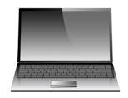
Writing Activity
Open a document you are currently writing, a past assignment, or your CV/resume
Begin to revise and edit to APA style based on the 7th edition
Ask questions as needed!
“Effective scholarly writing balances continuity and flow with conciseness and clarity” (APA, 2020, p. 111).

Slide 21
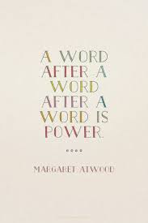
Additional Resources
https://apastyle.apa.org
https://apastyle.apa.org/blog
https://digitallearning.apa.org/academic-writer
Visit the Kean University Writing Center:
https://www.kean.edu/offices/library/writing-center
Dr. Kendahl Shortway: shortwak@kean.edu

Slide 22
Your Feedback Matters
Please begin the survey!
Thank you for joining us today…
Happy writing, and have a wonderful semester!

