Slide 1
Dr. David S. Hood Provost and Sr. Vice President for Academic Affairs Minnesota State University, Mankato Founder and Associate Innovative Higher Ed Solutions

Slide 2
 | Montclair State University | North Carolina Central University
Location | Montclair, NJ | Durham, NC
Enrollment | 21,671 | 6867
Institutional Designation | MSI/HIS | HBCU
Carnegie Classification | Doctoral Research University High Research Activity R2 | Master’s Large Programs
Ethnicity | Asian………....................... 6% Black/African American… 13% Hispanic/Latino…………….. 30% Two or More Races………… 3% White……………………………. 43% Unknown………………………. 3% | Asian……………………………………. 1% Black/African American………… 74% Hispanic/Latino……………………. 7% Nonresident Alien………………… Two or More Races………………. 5% White…………………………………… 11% Unknown……………………………… 2%

Slide 3
North Carolina Central University Catalyst for Change
 | # of FTF | # FTF Retained | % Retained
Fall 2009 | 1346 | 908 | 67.5
Fall 2010 | 1218 | 825 | 67.7
Fall 2011 | 1244 | 890 | 71.5
Fall 2012 | 1387 | 1015 | 73.2
Fall 2013 | 922 | 706 | 76.6
Fall 2014 | 923 | 737 | 79.8
Fall 2015 | 1101 | 889 | 80.7
Fall 2016 | 1128 | 872 | 77.3
Fall 2017 | 1264 | 1040 | 82.3

Slide 4
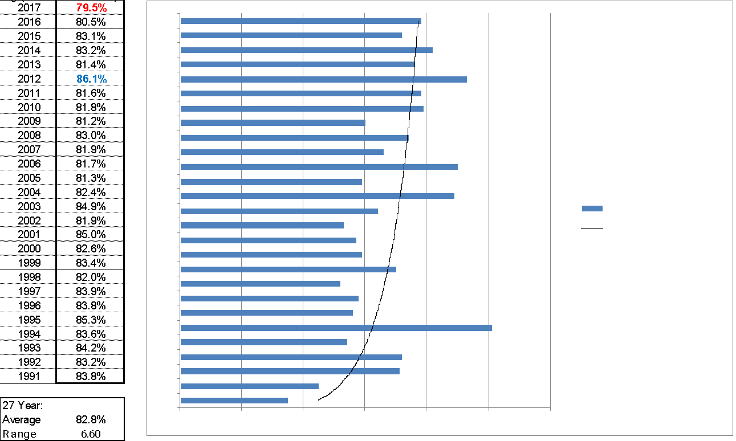
Montclair State University Catalyst for Change

Slide 5
WHAT IS KEAN UNIVERSITY’S CATALYST FOR CHANGE?

Slide 6
Audience can respond at PollEv.com/davidhood622 or Text DavidHood622 to 22333 once to join, then text your response

Slide 7
The University College Model
 | Montclair State University | North Carolina Central University
Population Served | Pre-Major Students | Total Intake
# of Students Served | 1500-1800 | 2,500-3,000
Transition Point | Rolling Transition | 60 credits
Number of Advisors | 7 Advisors | 13
Case Loads | 250-300 | 200-225

Slide 8
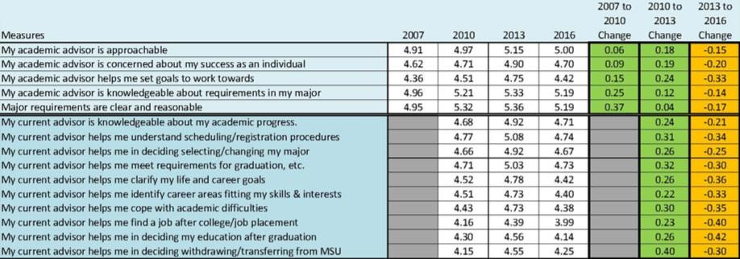
Catalyst for Advising Reform
The Ruffalo Noel-Levitz Student Satisfaction Inventory Results 2007-2016

Slide 9
Catalyst for Advising Reform Continued
Fall 2017 First Year First Time Freshman Retention Rate 79.5%
Lack of Shared Vision
Inconsistent Strategy
Minimal Use of Early Alert/Early Warning System
Registration and Distribution of Pins Primary Focus
No Student Learning Outcomes
No communication strategy
Decreasing satisfaction with advising services
No advising syllabus for the campus

Slide 10
The Journey Toward Redesign
Bi-monthly meetings with assistant, associate deans, and directors of advising Fall 2018
Registration
Course substitutions
Distribution of PINS
“Registration clerk” mindset (Karp 2013)
Call of next-gen advising
Advising Summit Committee appointed

Slide 11
The Journey Continued
Advising Summit
college deans, faculty advisors, professional advisors, advising leads, and other advising –focused campus partners
SSIPP approach was introduced
NACADA core pillars and values were reviewed
Ruffalo Noel-Levitz Student Satisfaction Inventory data on advising was shared
Reviewed student data at the college level

Slide 12
Summit Objectives
Develop what a shared vision for a transformed advising experience can look like
Begin to develop a caseload advising model with campus-wide student learning outcomes

Slide 13
Summit Outcomes
Phase one proposals for caseload management developed
CHSS immediately implemented case load management
Advising Leadership →→ Advising Strategy Group
Advising Counsel
Block Scheduling and Enrollment
Advising and Analytics Platform Implementation
New Student Redesign Team
Advising Training, Recognition and Rewards

Slide 14
SSIPP (College Research Center, 2013)
Sustained
Strategic
Integrated
Personalized
Proactive

Slide 15
Proactive advising is a preemptive approach to work with students in which advisors try to anticipate and look for concerns, roadblocks, and other barriers that could potentially prevent students from being successful (Varney, 2017)
Proactive Advising
Defined

Slide 16
A process in which advisors address key variables of student attrition before they transpire, rather than as a reactive process.
Proactive Advising
Defined

Slide 17
Proactive advising is a process helps students identify potential barriers early in their academic careers. Proactive advisors helps students build solid academic and social foundations that will help them progress toward their goals.
Proactive Advising
Defined

Slide 18
Bottom line…What are you saying????????? • Strategic efforts to develop and advise the whole student, action oriented. • Academically, professionally, and personally • Addressing challenges and barriers before its too late

Slide 19
Obtaining a signature to register
A registration event held once per term
Holistic and Proactive Advising IS NOT!!!
Focused exclusively on a student’s academic experiences
Telling students what to do
A judgmental process
Waiting for students to visit you

Slide 20
The Why?
Leaders are recognizing the value of enhancing advising programs
Develops working partnership that focuses on learning
Clearly articulates the function of advising
Student Success
Focus is shifting from access to retention and completion
Consistency
Personable experience/caring atmosphere

Slide 21
Together with academic advisors, students examine their learning styles, habits of working, and current difficulties or barriers to success.

Slide 22
The Research
Proactive advising is effective when it involves personalized outreach that expresses individualized consideration and care
Proactive advising that involves individualized consideration and care positively impacts persistence.
Pipkins, 2021

Slide 23
PART II

Slide 24
Recommendations
Increase Personable Student Interactions with Proactive Advisors
Have personable interactions regularly
Focus extends beyond registration campaigns
Emphasis on sense of belonging and finding equitable and inclusive opportunities for students
Case management
***Get students attention

Slide 25
Recommendations Continued
Techniques and Tools
Self-assistance services that the advisor can provide to students
Increase structured group learning experiences
Advising Syllabus
Communication
Non-Academic Needs Assessment
A case management approach

Slide 26
Recommendations Continued
Frequency of outreach activity
Mode of communication
Student target population per communication
Message topics

Slide 27
Non-Academic Needs Assessment
Students, specifically those that are considered at-risk are often overwhelmed with external commitments that can impact their academic success. As a result, it is recommended that students self-identify external needs with the help of an advisor.
(Fusch, 2012)

Slide 28
Non-Academic Needs Assessment
Assist students with assessing external needs by providing them with a needs checklist.
Example:
I need assistance with:
Transportation
Childcare
Healthcare
Life skills
Balancing school and work
Housing

Slide 29
CASE MANAGEMENT
Case management involves the advisor partnering with the student to attain specific goals
Create a plan that is catered to the student individual needs from a holistic perspective (developing the whole student)
*Academically, professionally, and personally

Slide 30
Advising Curriculum Items
Educational planning
Program of study/major
Technology
Prerequisites, Advisories, College Readiness
Courses descriptions and course specific content

Slide 31
Advising Customize Curriculum
Academic map/Educational Plan
Goal Setting/Renew & Revisit goals
Financial aid literacy
Resources
Career Planning
Time management

Slide 32
Benefits of These Intentional Approaches
• Encourages students to participate in advising early and promotes a sense of care from advisors
• Minimizes delay in creating long - term view toward students' goals
• Familiarity with advisor, promotes active case management
• Sense of Belonging/Relational

Slide 33
TIPS
Make the most of critical timing in your outreach points
Improve internal and external communication
Use data and predictive modeling to inform practice and activities
Engage students
Maximize content and delivery of content
(Connell, 2018)

Slide 34
LESSONS LEARNED
Student Success Is Everyone’s Business
All Senior Executives Must Own Advising and The Student Success Agenda
One Executive Should Manage The Work, No Distributed Management
Engage Faculty Early and Often
Administrator and Staff Evaluations, and Faculty Promotion and Tenure Guidelines Must Reflect That Student Success Is Important

Slide 35
BEYOND ADVISING
First Year Seminar Redesign
Embeded Peer Mentoring
Course Redesign for High DFW Rate Courses
Undergraduate Research
Enhance Academic Support Services
Tutoring
Supplemental Instruction

