Slide 1
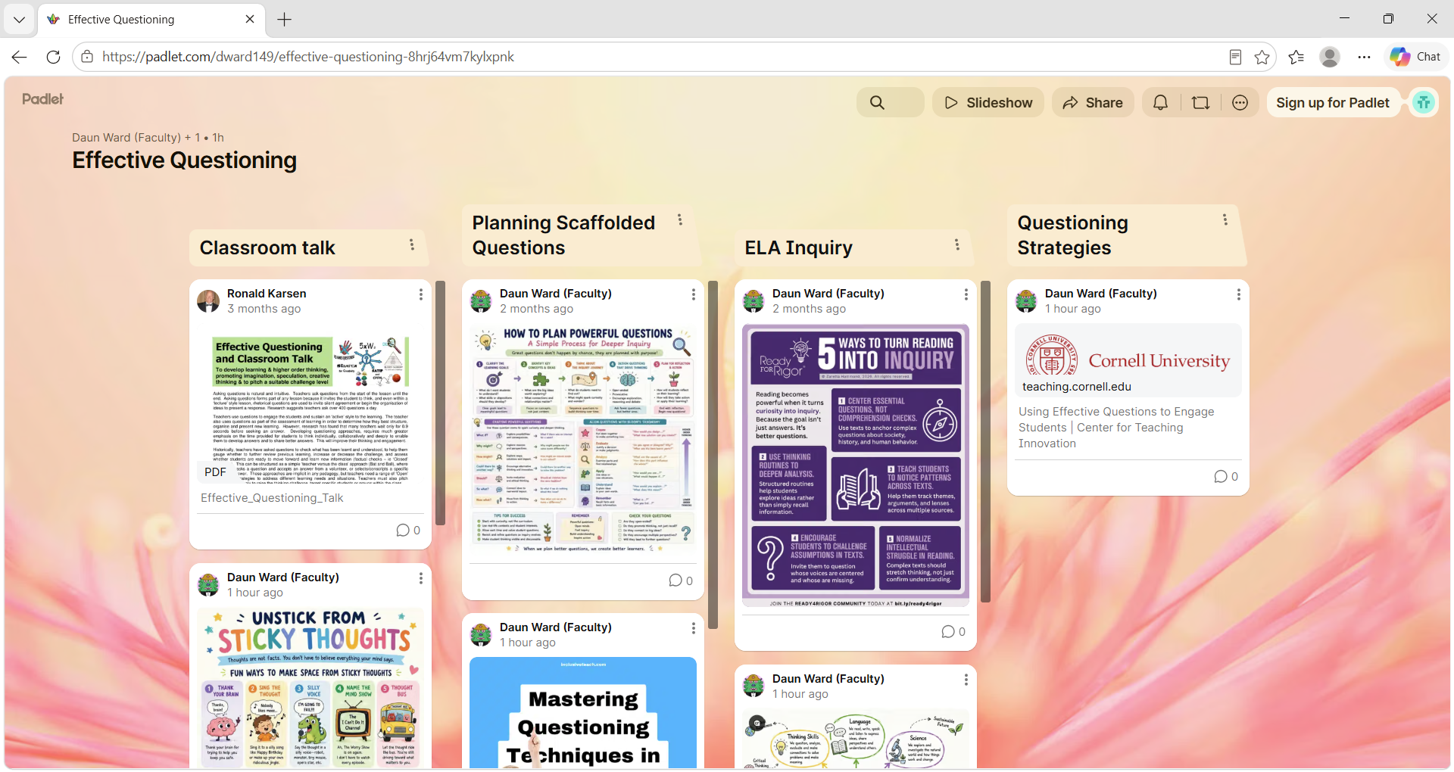
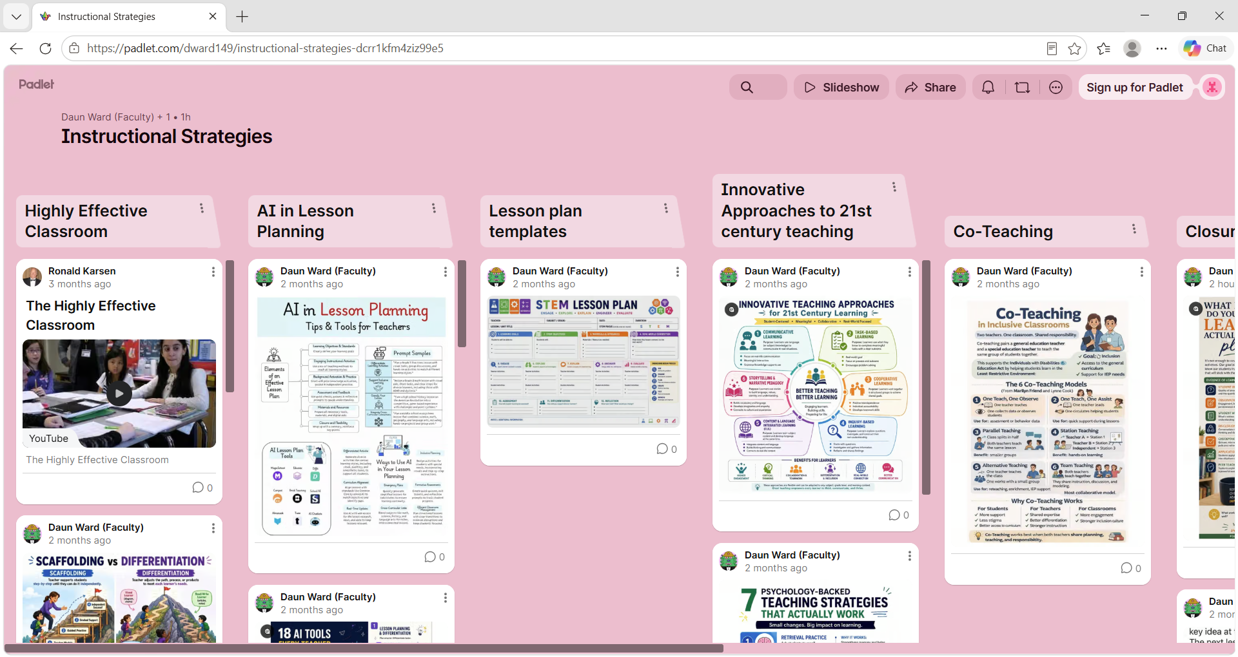
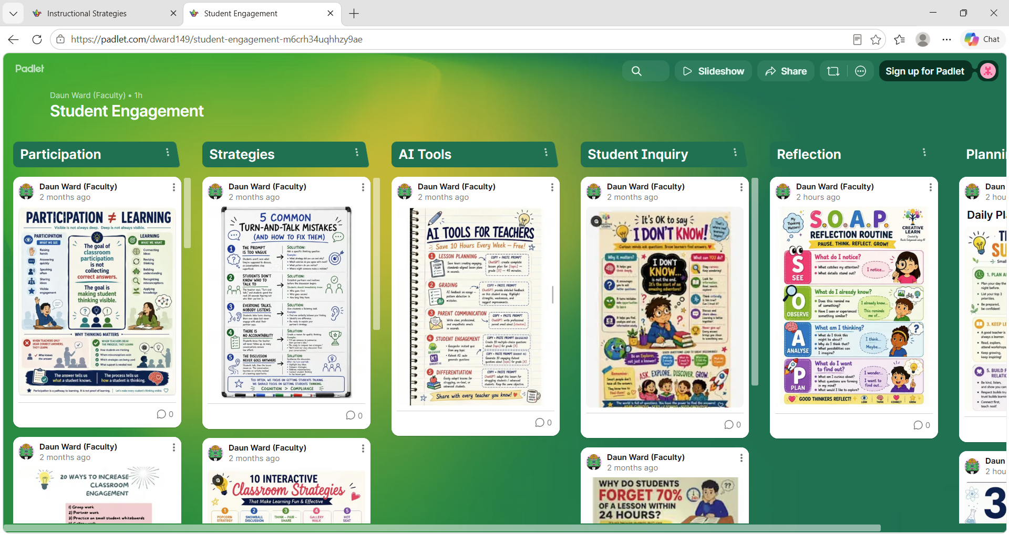
Instructional Strategies
Fall 2026 Implementation
Three New Toolkits
Effective Questioning
Student Engagement
Instructional Strategies
F

