Slide 1
Proposal to
Revise General Education
at Kean University
by the GE Task Force
University Senate
Open Hearings
October 2, 2025
October 3, 2025
October 9, 2025
Notes:
Rachel: Thank you to Craig and all Senators for the opportunity to welcome everyone to today's Open Hearings. I am Rachel Evans, Chair of the Dept. of Theatre and before I begin, I would be remiss if I didn't remind you that our Theatre season opens on October 10th with Dominque Morisseau's play about the race riots in Detroit in 1967. Free tickets are available to all employees for Thursday, October 16's 5:30pm performance in partnership with Kean's Wellness at Work program. And come early to view our Theatre Design exhibit, curated by Professors david Barber and Karen Hart, in Vaughn Eame's James Howe Gallery. But today I appear before you in my capacity as chair of the GE Task Force.

Slide 2
Insert list of participants in the GE revision process
since May 13, 2022
At least 1000
students, faculty, & staff from committees, pilots, and Zooms
—oh, my!
Notes:
Rachel: When preparing for today's presentation, the Provost requested that I create a slide with the names of all the participants who have contributed to the process to revise the GE Program since the Task Force was formed in May 2022. Dr. Birdsell: I tried. But as I started to design a slide, I realized that there are literally hundreds of people who have had a hand in this process—from those who travelled to Kean Skylands for a January 2023 retreat, to the Task Force members who met in the CTL to strategize for early "Bread Givers" and train iterations of the redesign—from the committee members who reviewed the Considerations document last Spring, to the hundreds of students and faculty who are part of this Fall's pilot. There are too many to name, and I wouldn't want to leave anyone out as the contributors continue to grow. Just this week Bridie and I met with a team of COE folx, received emails from the COMM department, and worked with Brid and Abby, Jonathan and Joy to lay the groundwork for the curricular work yet to come. It has taken the whole village to get to this point. So where are we? Bridie and I are going to give as brief an overview as possible.

Slide 3



Understanding the Proposal:
Basics of the Proposed Structure
FROM
TO
Rationale
Foundation/Distribution, Discipline-based model
  Outcomes-based model, implements High Impact Practices (HIPs)
Students do not understand how the courses "fit together" in the Foundation/Distribution model.
Students who switch majors may need additional courses delaying time to graduation.
Research proves that the strategic implementation of HIPs fosters deeper learning and a sense of community.
Notes:
Bridie

Slide 4
Understanding the Proposal:
Using GE PLOS & High Impact Practices (HIPs)
TO: HIPs
FROM
TO: New PLOs
  Theme-based communities in Semester 1
  Writing-intensive course after Essential Learning course in Written Communication (2 semesters of writing)
  Consistent & intentional use of e-portfolios
  Experiential learning activities
  Common intellectual experiences (like the Common Read)
  A Passion Project research experience in Year 2
  10 GE PLOs
  Written & Oral Communication as separate PLOs
  Information Literacy & Technology is embedded in multiple SLOs
  Wellness, Reading, Inquiry & Analysis added
8 GE SLOs (Essentially 10 SLOs)
  Written & Oral Communication as one SLO
  Information & Technology Literacy as one SLO
Notes:
Bridie

Slide 5
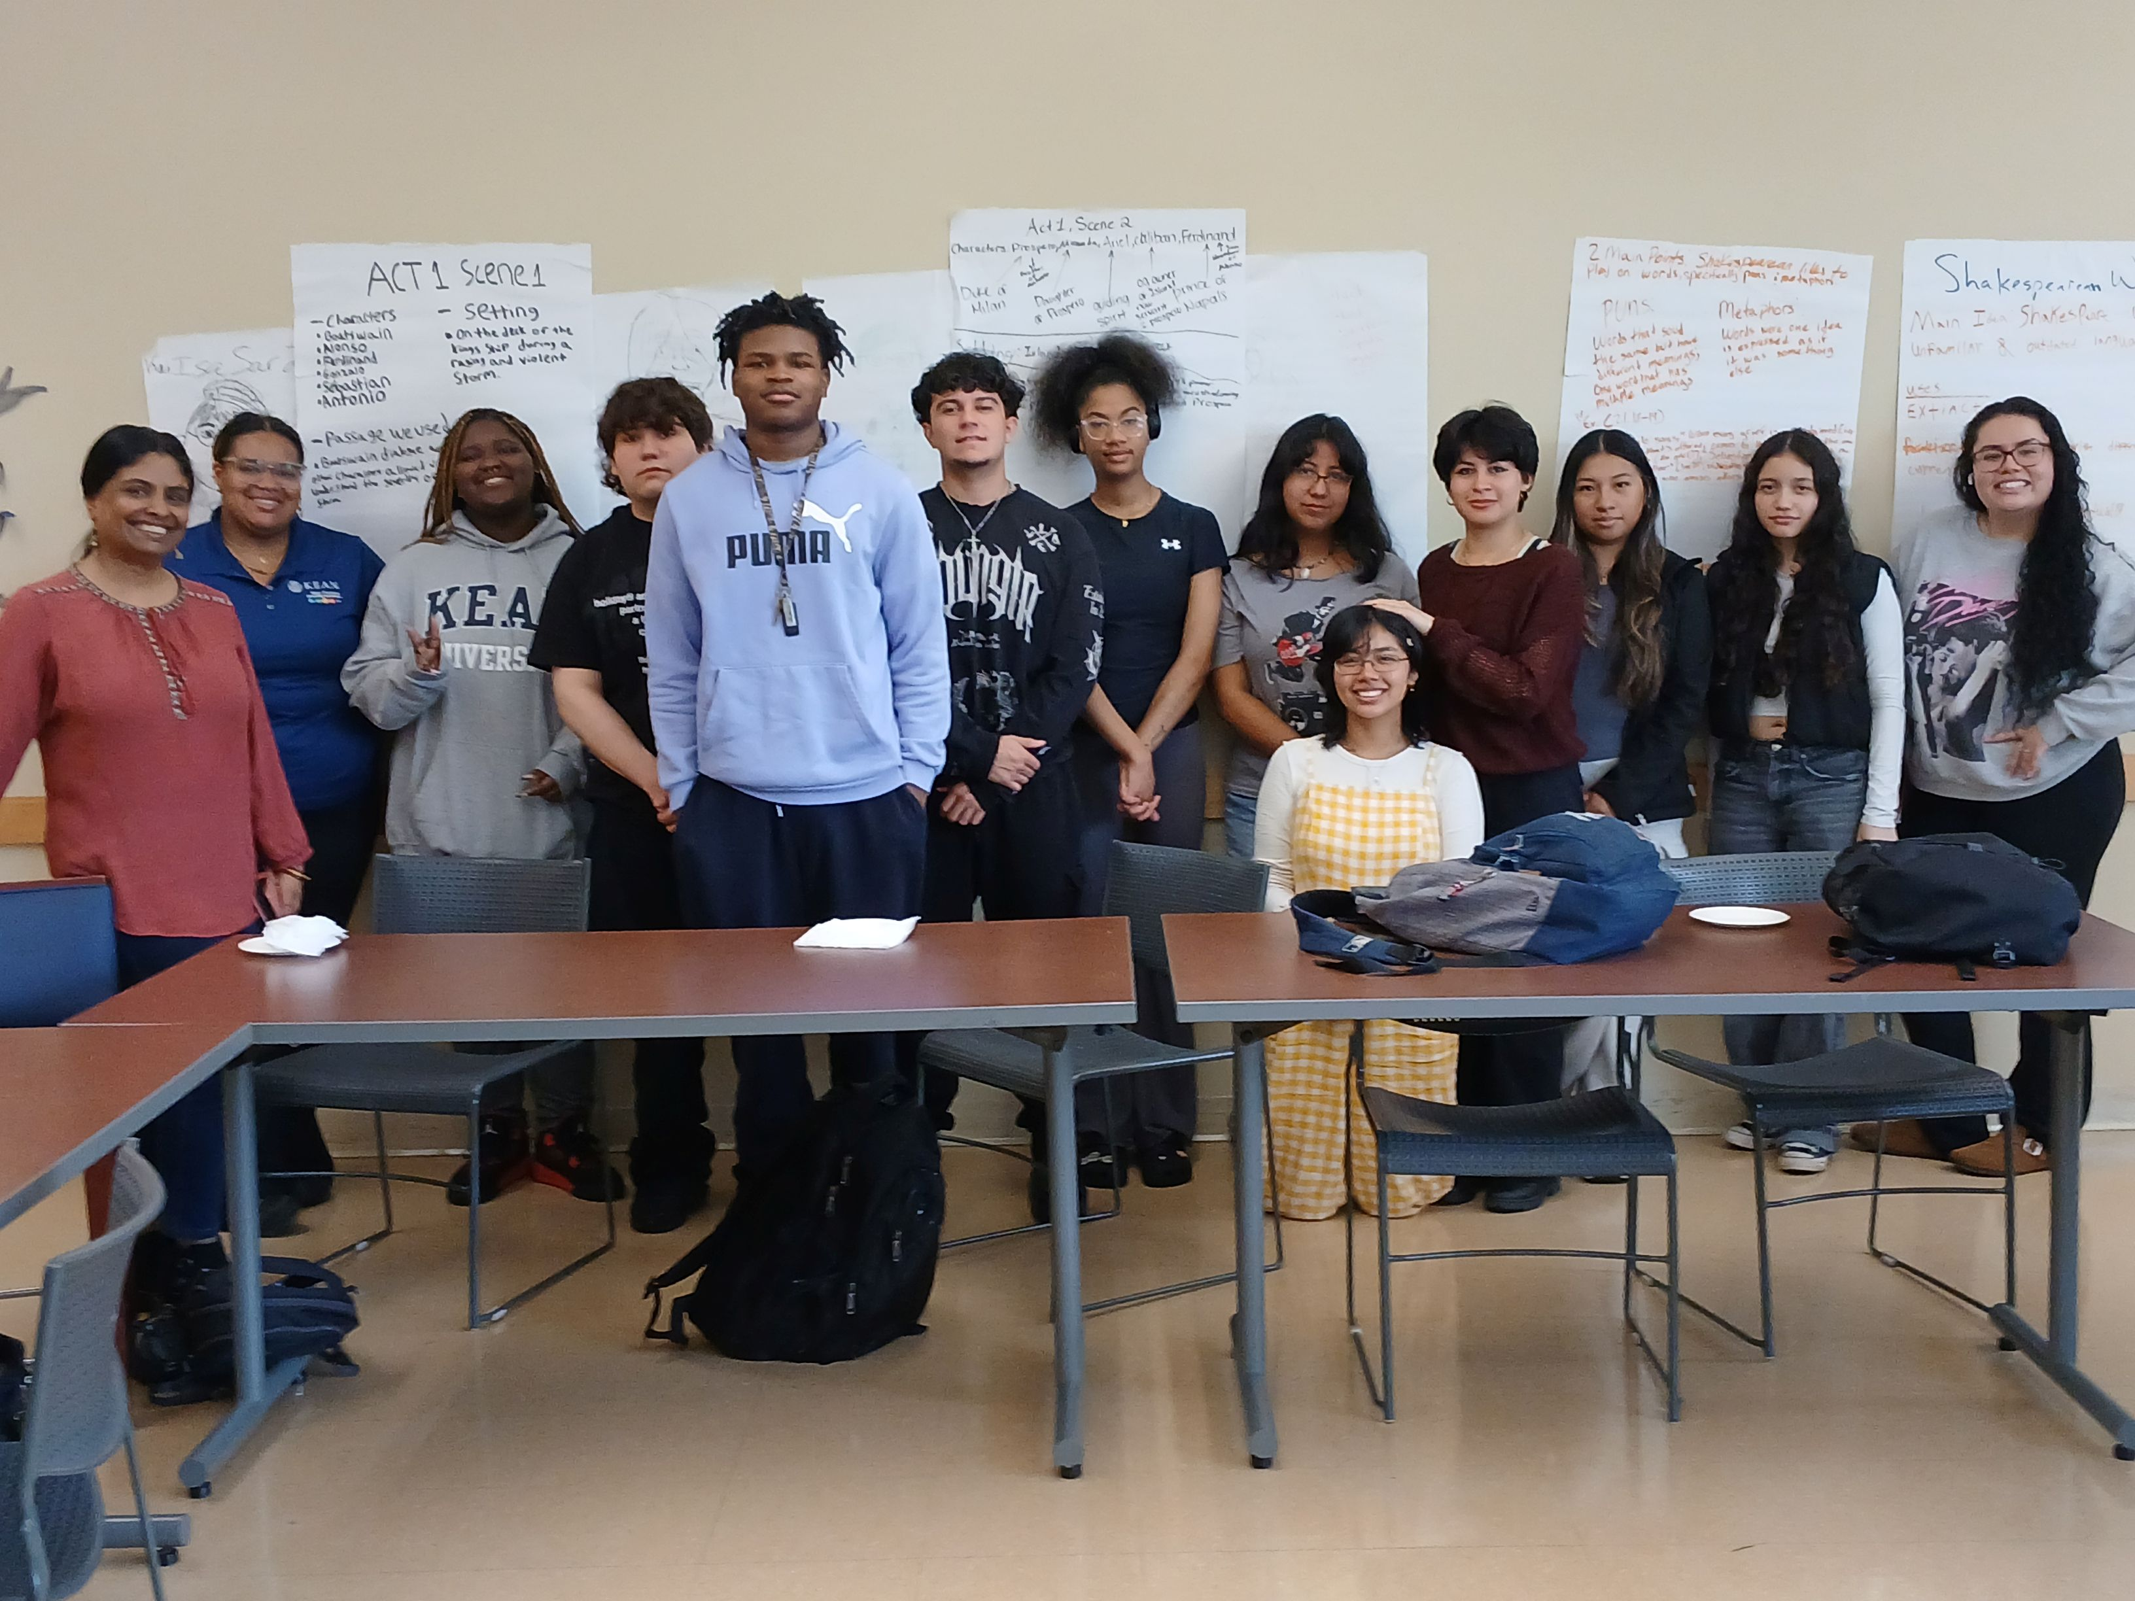
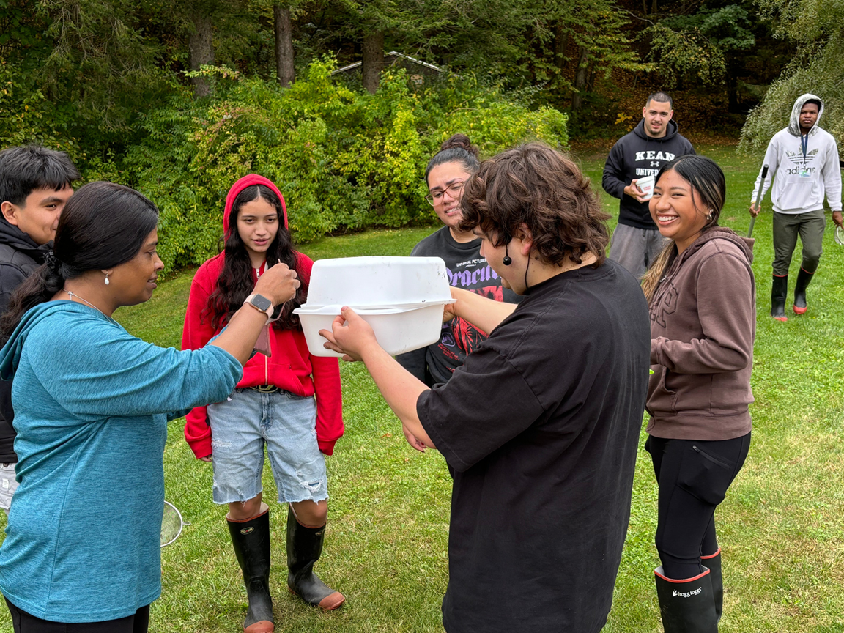
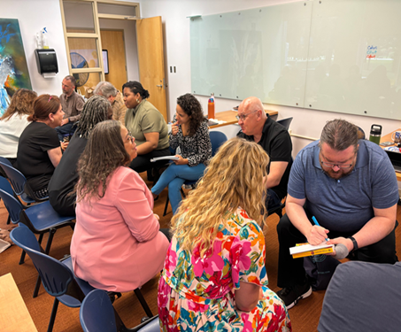
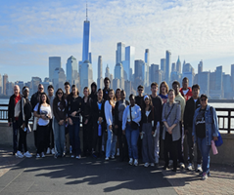
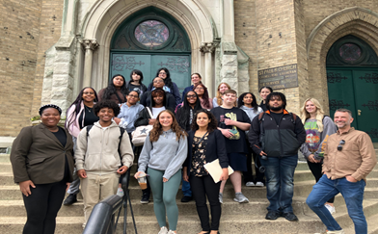
Understanding the Proposal:
Basics of the GE Learning Communities
Students take two courses in a paired cohort (e.g. ENG1030 + SOC1000 or COMM1402 + PSY1000)
Each cohort has a shared theme that ties the classes together & creates an Integrated Learning experience
Themes: Migration / Civic Engagement / Sustainability / Wellness / Urban Education
​
Active Teaching Strategies ​
Fostering belonging ​
Experiential learning​
Inquiry-based learning ​
​
Collaborative Syllabus Design ​
Making connections across disciplines ​
Linking classes to cohort themes ​
Developing shared assignments and assessments
Planning out-of-class activities and trips
Highlights
GE Fellows - faculty leading faculty​
High Impact Practices (ePortfolios)​
Off-campus excursions
Notes:
Bridie

Slide 6

THE COUGAR CORE
31-32 credits
Essential Learning Courses
16-17cr.
Core Competency
Courses
12cr.
Includes
Writing-
Emphasis
Course
The Passion Project
3cr.
Written Communication
3cr.
Intercultural Knowledge & Understanding
3cr.
Integrative Learning
Speech Communication
3cr.
Wellness
3cr.
Inquiry & Analysis
Quantitative & Scientific Reasoning
6-7cr.
Ethical Reasoning
3cr.
Critical Reading
3cr.
Quantatative & Scientifc Reasoning
6-7cr.
Critical & Creative Thinking
3cr.
Academic Skills
1cr.
Notes:
Rachel: In response to feedback received in Spring 2025, the Task Force's Cougar Core is now proposed to be 31 – 32 credits for all students—BA and BS alike. Its 10 PLOs are organized into three course categories: Essential Learning, Core Competencies, and the Passion Project. In semester 1, students would participate in learning communities created by paired courses, uniting a cohort of students with 2 faculty members who are working together to deliver a thematic-based inclusive and experiential curriculum. It is hoped that the theme and explorations in the learning communities would inspire the students to design their Passion Project, or some other approved college-based research endeavor, during Year 2. In the meantime, students will have the freedom to take the rest of their Cougar Core requirements as best suits their degree aspirations, knowing that once they've satisfied a PLO requirement, they can change majors without needing to retake any GE courses, with exceptions being made for licensure and accreditation purposes.

Slide 7
Understanding the Proposal:
Theme-based Learning Communities in Semester 1
FROM
TO
Rationale
  Menu of disconnected GE course experiences
  Thematically paired courses to create program-wide learning communities centered around faculty-identified topics in a sustainable manner
  Based on data from 2024 & 2025 pilots
  Immersive experience for students & faculty
  Support retention & graduation rates
  Deepen students’ sense of belonging in Year One
Notes:
Rachel: So we'd go from a menu of disconnected GE experiences to thematically-paired courses in Semester 1 to create program-wide learning communities centered around faculty-identified topics in a sustainable manner. Data from the 2024 & Spring 2025 pilots indicated that students appreciated sharing the immersive experience with their peers and their paired faculty, that they intended to stay at Kean, and that their sense of belonging might support commitment to their path to graduation.

Slide 8

The Process according to the
UCC Manual
Preliminary Review Process
  UPC writes recommendations COMPLETED February 25
  GE Committee writes recommendations COMPLETED March 10
  OAA writes recommendations COMPLETED March 12
  UCC writes recommendations COMPLETED March 31
  University Senate holds open hearings TODAY!
  University Senate writes recommendations COMPLETED May 14
  GE Task Force revises document. COMPLETED August 28
The Approval Process
  University Senate takes action to approve
  Provost approves
  President approves
  Board of Trustees approves
  Action is initiated to implement
Notes:
Rachel: And that's where we are. It's been 220 days since the UPC sent its recommendations to the Task Force, and since then we've revised the Proposal to address their feedback, as well as that of the GE Committee, the Office of Accreditation & Assessment, the University Curriculum Committee, and the Senate.

Slide 9

Thank you!
Notes:
Rachel: We look forward to these Open Hearings and the rest of the Approval Process.

Slide 10

Realignment of existing GE SLOs
with proposed GE PLOs
Existing GE SLOs
Proposed GE PLOs
Transdisciplinarity
Integrated Learning
Critical Thinking
Critical & Creative Thinking
Quantitative Literacy
Quantitative & Scientific Reasoning
Communication Literacies:
Written and Speech Communication
Written Communication
Speech Communication
Ethical Judgement & Integrity
Ethical Reasoning
Diversity
Intercultural Knowledge & Understanding
Active Citizenship
Wellness
Information & Technology Literacy
Inquiry & Analysis
Critical Reading
Information & Technology Literacy, Including ethical use of AI,
will be embedded in multiple PLOs & major-facing courses.

Slide 11
THE COUGAR CORE GRADUATION MAP
Semester | GE Requirements | Additional Courses
Semester 1 | Academic Skills (1cr) Two Courses Linked Thematically in a Learning Community (6-7cr) Essential Learning Course (3cr) + Essential Learning Course (3-4cr) OR Essential Learning Course (3-4cr) + Core Competency Course (3cr) | Combination of: Essential Learning Courses Core Competency Courses Major-Facing Courses
Semester 2 | Writing-Emphasis Course from Core Competency Courses (3cr) | Combination of: Essential Learning Courses Core Competency Courses Major-Facing Courses
Semester 3 or 4 | The Passion Project (3cr) A major-facing, writing -intensive research methods course focused on Integrative Learning and Inquiry & Analysis | Combination of: Essential Learning Courses Core Competency Courses Major-Facing Courses
Semester 7 or 8 | The Capstone Course (3cr) | Combination of: Core Competency Courses Major-Facing Courses
Additional Core Competency Courses and Major-Facing Courses are included in Semesters 5 & 6

Slide 12
Examples of Possible Alignment between New GE PLOS & Current GE Distribution Courses
New GE PLOs | GESM Distribution Courses | GEHUM Distribution Courses | GESS Distribution Courses
Integrative Learning | SUST 1000, ENV 1000, ENV 1100; College-Facing Second Year Research Course /Passion Project | HIST 1062, GE 1855, MUS 2220, College-Facing Second Year Research Course /Passion Project | GS 2500, ANTH 2805, College-Facing Second Year Research Course /Passion Project
Critical & Creative Thinking | BIO 1000, BIO 1200, BIO 1300, BIO 2402, ENV 1000, ENV 1100, SUST1000 | FA1000, MUS 1000, MUS 1050, MUS 1051, PHIL 1100, PHIL 2505, THE 1100, THE 1000 | ECON 1020, ECON 1021, PS 1010, PS 2100, PS 2300, SOC 2100, PSY 1000
Quantitative & Scientific Reasoning | BIO1000, BIO 1200, BIO1300, BIO 2402, CHEM1200, CHEM1030, CHEM 1083, CHEM1084, CPS 1231, ES 1000, ES 1100, ES 1200, ES 1300, ES 1400/2400, ENV 1000, ENV 1100, FSC 1000, ID 1400, PHY 2091, PHYS 2092, SUST 1000, MATH1016, MATH1054 |  | SOC 2052
Written Communication |  | ENG1030
Speech Communication |  | COMM1402
Critical Reading & Academic Skills |  | ID 1451, ID 1500, GE 1855, GE 1000/3000
Ethical Reasoning | BIO 1200, SUST 1000, ID 1350, ID 1400, CPS1032, FSC 1000 | PHIL1100, PHIL2300
Intercultural Knowledge & Understanding | ES 1010 | AH1700, AH1701, ENG2403, ID1300, REL1700, REL2700, REL2701, ID1300 | ANTH1800, GS2500, HIST1062, PA1001, PS2400, PS2500, SOC1000, SOC2300
Wellness | BIO 1000, BIO 1200, BIO 1300, BIO 2402 | PSY1000, ID1300
Inquiry & Analysis | College-Facing Second Year Research Course /Passion Project; 4th Year GE/Major Capstone | College-Facing Second Year Research Course /Passion Project; 4th Year GE/Major Capstone | College-Facing Second Year Research Course /Passion Project; 4th Year GE/Major Capstone

Slide 13

High Impact Practices
(HIPs)
with proven track records
  Theme-based communities in Semester 1
  Writing-intensive course after Essential Learning course in Written Communication (2 semesters of writing)
  Consistent & intentional use of e-portfolios
  Peer-to-peer support through GEMs & embedded tutoring
  Experiential learning activities
  Common intellectual experiences (like the Common Read)
  A Passion Project research experience in Year 2
Notes:
Bridie: Also included in the PLO-based Cougar Core would be increased attention to High-Impact Practices, giving all Cougars equitable access to research-based interventions that would aid student learning.

