Slide 1

Navigating ESM Purchase
Smarter Purchasing
September 29, 2025

Slide 2
Presented By:
Faruque Chowdhury​
Margaret Czerwonka​
Donna Britt​
Aniesa Atiyyeh​
Tewelde Daniel​
Yelena Khaytin
Judy Pavese
Marissa McYeng

Slide 3
Agenda
Announcements​
Helpful hints and best practices​
Amazon and WB Mason purchases
Legal review​
Bids ​
Change Orders
Common errors and resolutions​/Approval Flows
Change orders​
Receive​
Project Accounting

Slide 4

Announcements
Effective July 1, 2025, the Bidding threshold increased to $119,800​
Updated bid waiver form available online: https://www.kean.edu/offices/university-procurement-and-business-services/forms​
NJ Business Registration Certificate (BRC) requirement threshold increased to $17,970 ​
Receive function is now fully operational in ESM purchase for FY 2026 purchase orders

Slide 5
Helpful Tips
Send all agreements and any quotes over $25K to legal review prior to entering the transaction
Itemize the order – do not bulk in one line (unless BPO)
Do not future date Start dates of Blanket POs
Do not leave End dates of Blanket requests blank

Slide 6
Helpful Tips
Check Internal Notes for communication from approvers
Search for companies with 1 to 2 keywords only
Avoid using “the” “of” and “for”
Search for individuals by last name only

Slide 7
Helpful Tips
If you notice a workflow issue, Do Not click on Request Approval – enter a ticket for Kean IT support
For vendor questions/issues, ESM navigation, please email:
procurement@kean.edu
Check ESM Resource Center for helpful articles and tools

Slide 8
Helpful Tips
If your transaction is rejected, it will route back to All Transactions but will still encumber the funds
If you need to redo the transaction (from blanket to PO), be sure to delete the original transaction (trash can icon)
Do not receive your PO if change order is required
Do not close your PO when Receiving

Slide 9
Helpful Tips
DOs:
Obtain a quote
Check your budget before you order
Check status of your order
DON’Ts:
Don’t allow confirming orders to occur
Don’t enter more than 1 line for BPO request
Don’t enter ESM Solutions ticket on your own

Slide 10
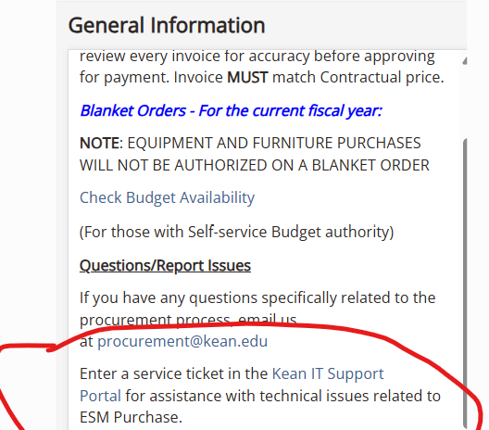
Helpful Tips
Do not submit requests via ESM Support
For questions or issues email: yelena.khaytin@kean.edu
For IT issues, click on the link in General Information box

Slide 11
Best Practices
Plan ahead! Obtain quote, gather documents as applicable (i.e., W-9, BRC, agreement, etc.)
Review Operating Rules and Procedures https://www.kean.edu/offices/university-procurement-and-business-services/purchasing-operating-rules-procedures
Reach out to University Procurement and Business Services (UBPS) with purchasing questions or concerns (i.e., W-9, vendor questions, bid thresholds, limitations, etc.)
Avoid Confirming Orders - submit transaction ahead of start of service or purchase of goods
If urgent order is needed, contact UPBS right away via email
Food/catering orders – obtain a Formstack approval prior to entering a transaction
Accept your PO in ESM (FY 26) in a timely manner
Submit your invoice to Accounts Payable to pay the vendor

Slide 12
Amazon and
WB Mason Orders
Unapproved Items:
Whiteboards
Electric heaters
Furniture
Rejected Transactions: Please read rejection reason
Amazon - Delete the transaction and enter a new order excluding unapproved items
WB Mason – Remove unapproved item(s) and resubmit
Food items/food-related items – must obtain Formstack approval first

Slide 13
Amazon Business and WB Mason Orders
Internal Notes:
Please include a note if your purchase is out of the ordinary (justification)
Expired Carts:
Amazon Business transactions (carts) expire in seven (7) calendar days as of the transaction date
Must delete such order and start a new one
Delivery Details:
Please include your Department Name next to your name
Furniture Purchases:
We do not recommend purchasing furniture from Amazon Business or WB Mason

Slide 14
Bids
University-wide Bid Awarded Contracts
  Promotional Items
  ASL Interpreter Services
  Charter Bus Services
Bid Contracts Limited to Department
Utilize Vendors Awarded Bid Contracts First
  Exceptions require approval
BPOs for Goods (i.e., Promotional Items)
  Not to exceed $5,000
  Single line item
  For recurring purchases only
  BPOs with JCM should not be used for architectural signs
  Avoid rejections and delays in ESM

Slide 15
Transactions with Bid Suppliers
Attach the quote
  Verify pricing
  Verify scope of work
List individual line items
  Accurate description (from quote)
  Corresponding quantity and unit rate
  No $0 items
Change Orders
  Accuracy is important
Shipping Charges
  Enter in appropriate section

Slide 16
Legal Review
Contracts (Review and Approval)
Signature Authority
Does sign contracts for the purchase of equipment, materials, supplies and services only.
Does NOT sign affiliation, articulation agreements, MOU, MOA, grants, research agreements, or other similar agreements.
Contracts (Signature required)
The hiring of professional services, any value.
Goods and services in excess of $50,000.00.
Any public works and construction contracts of any value.
Any project in which workers are employed and paid in accordance with the New Jersey Prevailing Wage Act.

Slide 17
Legal Review
Terms and Conditions
Indemnification
Governing Law/Jurisdiction in a state other than New Jersey
Arbitration
Terms & Conditions links
Amendments (in writing)
Scope of Services
Term
Payment

Slide 18
Legal Review
Legal Review
All contracts shall be sent to UPBS for review prior to signing. UPBS will consult with University Counsel as necessary.
Allow a minimum of fourteen (14) business days for legal review of any vendor contract.
UPBS Responsibility & Signature
W9 form
Authorized Funds (Bid Waiver, Co-op, etc.)
NJ Business Registration Cer tificate
Outside Disclosure Form

Slide 19
Legal Review
Confirming Orders
You will be required to contact the CFO’s office
HELPFUL TIPS
Do not receive goods or services before agreements are signed to prevent confirming orders
Indicate accurate start and end dates when applicable
Submit contracts and amendments with adequate time for review
Submit contracts before entering ESM transaction
Provide “out of the US” Disclosure form for non-US based vendors with contract submission
Seek vendors’ signature first where applicable
Urgent/Emergency situations – please inform us upfront
CONTRACTS PORTAL (Form only)
https://forms.office.com/r/d683RF4wcT

Slide 20
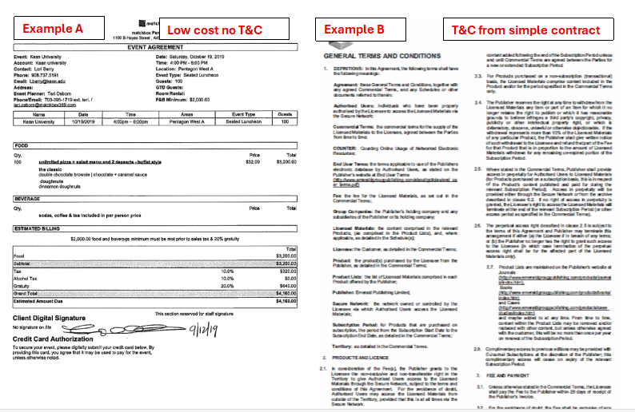
Legal Review

Slide 21
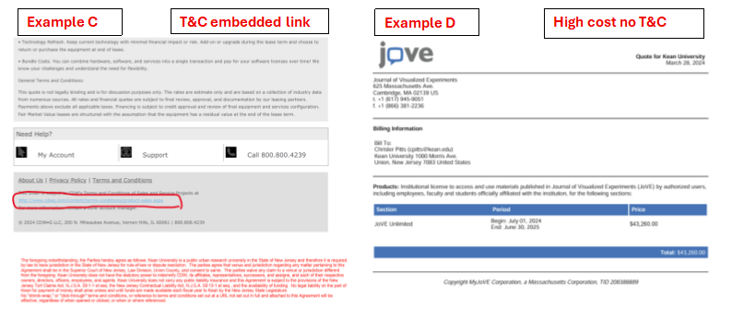
Legal Review

Slide 22
Confirming Orders
A confirming order is a transaction presented for payment after goods/services were provided
A confirming order is a violation of University policy and must be avoided
Approval to be obtained from CFO’s Office by the SVP in charge of the requesting department prior to entering a transaction
Approval email must be attached to transaction with submittal (Internal Attachment)

Slide 23
Common Errors and Resolutions
Budget Error Message = Funds are not available
Resolution: Move/transfer the funds and click on Request Approval
500 Gateway Timeout error = Connectivity issues
Resolution: Try again later/logout of application and log back in

Slide 24
Common Errors and Resolutions
Workflow issue (bypassing levels) = Information is not available for this cost center
Resolution: Do Not click on Request Approval; enter a ticket through IT support portal
400 Bad Request Vendor ID must correspond with a valid vendor record = vendor inactive and not approved
Resolution: Contact Procurement for assistance before trying to request approval again
Error: "The initiator.detail.id is required.”
Resolution: Submit Kean IT support ticket through IT portal https://helpdesk.kean.edu/support/home

Slide 25
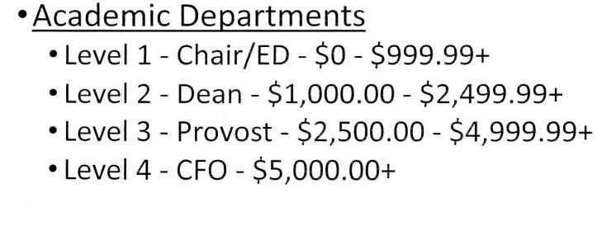
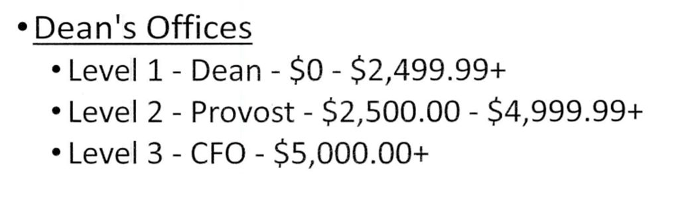
Approval Workflows

Slide 26
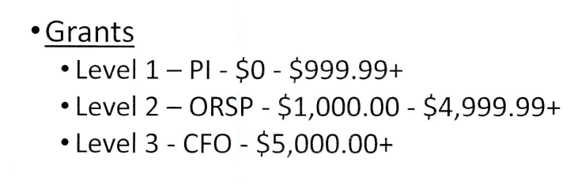
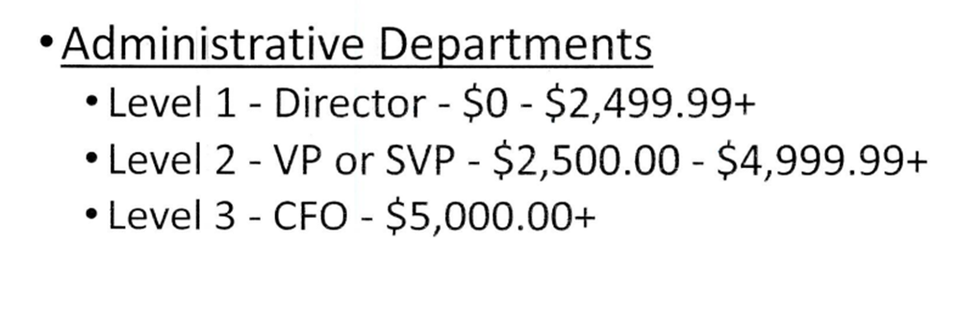
Approval Workflows

Slide 27
Approval Workflows
Additional levels may be added based on type of purchase as assigned by the object code:
Food services (50380)
Software purchases (50340)
IT equipment (50760)

Slide 28
Change Orders
If an adjustment of original Purchase Order is needed, the following steps should be followed:
Department should send an email to UPBS to request a change order and must provide an invoice with a detailed explanation of the change (i.e., line item, quantity, shipping charges, pricing, etc.) (judith.pavese@kean.edu)
UPBS will initiate a Change Order in ESM
***Do Not Receive PO***
3. Once a Change Order is fully approved in ESM, change will reflect in Ellucian
4. Only after the Change Order has been fully approved and adjusted department may receive the PO and send invoice(s) to Accounts Payable

Slide 29
Receive
(for FY 26 POs only)
Click on Receive button
Click on purchase order you would like to receive or type the purchase order number in (be sure to include letter P)
Click on the Line Item Details
Enter qty received to match quantity
Click on Update
Do not click on Close Order

Slide 30
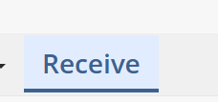
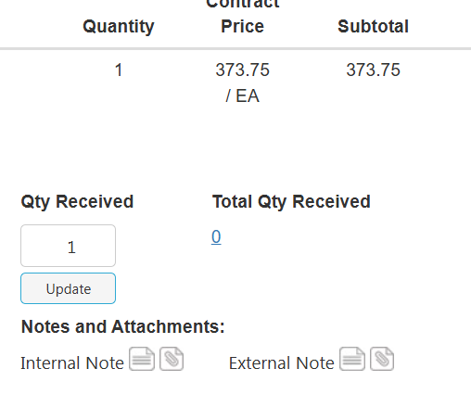

Receive

Slide 31

Project Accounting
Office of Research and Sponsored Programs

Slide 32
Key Differences with ESM Checkout and Project Accounting​
General Details
  Project ID is mandatory
GL Details
  Must select SaaS Chart of Accounts from dropdown
Enter the following:
  Fund
  Cost Center
  Object Code
  Project ID
​Summary:​
  The main change is that Project Accounting enforces strict alignment by requiring the Project ID in both General Details and GL Details, along with Fund, Cost Center, and Object Code.​
  It also requires using SaaS Chart of Accounts for coding transactions.​

Slide 33
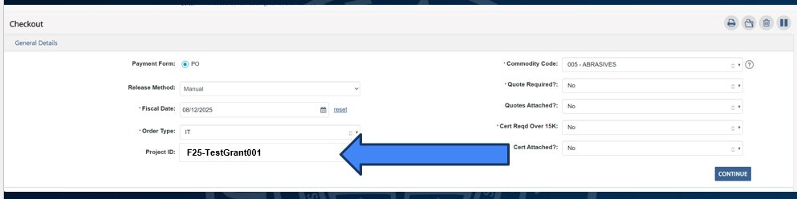
Project Accounting

Slide 34
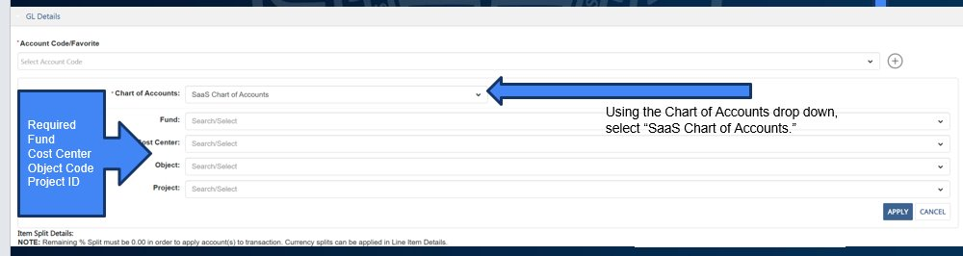
Project Accounting

Slide 35
ORSP Contact Information
For any questions, please feel free to contact at:​
Email: postaward@kean.edu
​ORSP staff are available ​
Monday – Friday​
9:00am – 5:00pm

Slide 36
Thank you!
University Procurement & Business Services
Email: procurement@kean.edu
Phone: 908-737-5050
For new user training:
Email: Judith.pavese@kean.edu
Phone: 908-737-5056

