Slide 2
Department of Occupational Therapy
Nathan Weiss Graduate College

Slide 3
Welcome to Kean University
What is Occupational Therapy(OT)?

Slide 4
Occupational Therapy
OT’s believe participation in your meaningful occupations (the valued activities and roles you have) impacts your health and quality of life

Slide 5
Occupational Therapy
Occupational therapy is a science-driven, evidence-based profession that enables people of all ages to participate in their occupations of life by helping them promote health and prevent—or live better with—illness, injury or disability.
Practitioners must complete supervised clinical internships in a variety of health care settings, and pass a national examination.

Slide 6
As an inclusive profession, Occupational therapy maximizes health, well-being, and quality of life for all people, populations, and communities through effective solutions that facilitate participation in everyday living.
See more at: http://www.aota.org/aboutaota/vision-2025.aspx#sthash.ddXyeFcO.dpuf

Slide 7
Pillars of AOTA Vision 2025
Effective: Occupational therapy is evidence based, client centered, and cost-effective.
Leaders: Occupational therapy is influential in changing policies, environments, and complex systems.
Collaborative: Occupational therapy excels in working with clients and within systems to produce effective outcomes.
Accessible: Occupational therapy provides culturally responsive and customized services.
Equity, Inclusion, and Diversity: We are intentionally inclusive and equitable and embrace diversity in all its forms.

Slide 8
Department of Occupational Therapy Vision
By 2025, the graduates of our masters and doctoral degree programs will excel in entry-level practice.
Through creative programming and active learning opportunities, students will become leaders who serve society.
Our graduates will create change through evidence based innovative practice.

Slide 9
Department of Occupational Therapy Mission
Our mission is to develop entry-level occupational therapists who will utilize clinical reasoning skills to think creatively, critically, and holistically to deliver occupation-based practice to increase health, wellbeing and quality of life.
We promote professional growth, lifelong learning and interprofessionalism through leadership, scholarship, and/or creative works. Through collaboration with local, national and global community partners, we create unique learning and service opportunities to meet the needs of a changing social, economic and technological environment.
We seek to create excellence through a diverse and inclusive student body in support of a culturally competent workforce meeting the occupational needs of society.
Kean University’s Department of Occupational Therapy supports the missions and goals of Kean University and Nathan Weiss Graduate College.

Slide 11
Essential skills of a Kean University OT student
Respectful, effective communication skills
Therapeutic, respectful interpersonal skills
Ethical, moral professional skills
Efficacious, mature, internally-driven psychosocial skills

Slide 12
Educational Goals of the Program
All graduates of our program will:
Exhibit the roles and responsibilities of an occupational therapist as defined by the American Occupational Therapy Association, consistent with state regulations:
Adheres to ethics and safety guidelines
Effectively articulates the value of occupation
Effectively communicates in both oral and written format
Understands costs and funding
Utilize clinical reasoning skills to develop client centered assessment, goals, and intervention that facilitate participation in meaningful occupation across populations, settings and practice areas.
Demonstrate professionalism throughout all phases of academic career and into entry level practice.

Slide 13
All graduates of our program will:
Appraise research and other resources to evaluate efficacy and implement occupation based services supporting best practice.
Collaborate with clients, community partners and inter-professional colleagues to meet society’s occupational needs.
Demonstrate a professional commitment to the promotion and advancement of occupational therapy.
Demonstrate respect for diverse life experiences and cultures.

Slide 14
Entry level OTD students have additional educational goals:
Demonstrates in-depth knowledge of practice models, policies and systems in current and emerging OT practice areas.
Utilize a comprehensive knowledge of evidence based practice in assessment and intervention across current and emerging practice areas.
Demonstrate active involvement in professional development, leadership, and advocacy.
Demonstrate advanced knowledge and skills through in-depth experiences in one or more of the following areas: clinical practice skills, research skills, administration, leadership, program and policy development, advocacy, education, and theory development by completion of an accumulating doctoral residency.

Slide 15
Masters vs. entry level OTD
Masters | entry level OTD
2.5 years to complete | 3.5 years to complete
73 total credits | 103 total credits
Two level II fieldworks required | Two level II fieldworks required
 | 14 week doctoral residency
*Kean University has been granted candidacy approval for an entry level OTD program by ACOTE (Onsite scheduled for 11/20)

Slide 16
OTD Program
In the doctoral residency, students will have the opportunity to develop advanced skills in one or more of 6 practice areas:
Administration, leadership, program and policy development
Advocacy
Education
Clinical practice skills
Research skills
Theory development
Students will have the opportunity to complete a project in one of these advanced practice areas as part of their residency

Slide 17
General Admissions Timeline
Application for next year’s application cycle will be available in September
Kean will be using the OTCAS system
Application deadline:
For OTD December 1, 2020
For MSOT January 15, 2021
Applications are reviewed and selected applicants are invited for departmental interviews: Fall202 /Spring 2021
Applicants receive admissions decisions: Early-late Spring 2021
Program will begin in Summer session II (~July 6, 2021)

Slide 18
Admissions Requirements
(See website for additional information)
Overall GPA of at least a 3.0.
Three letters of recommendation. One must be from an OT.
Minimum of 40 observation hours of occupational therapy services in two or more practice settings. *

Slide 19
Prerequisite Coursework
(See website for additional information)
Prerequisite Courses must be completed with a grade of a B or better
At the time of application, prospective students may have only three prerequisite courses outstanding/in progress.
However, due to the competitive applicant pool, the Admissions Committee encourages the completion of all prerequisite courses prior to application.

Slide 20
Important Prerequisite Information
Life Span Development and Anatomy and Physiology I & II must be taken within 5 years of applying to the program.
The lab portion of Anatomy and Physiology I & II must be completed in person (note exception for Spring & Summer 2020, may be extended to fall 2020. Check website).
Introduction to OT can only be taken at Kean.
You may register for this class by applying to be a non-matriculated student at Kean.
For more information on this, please visit the Office of the Registrar’s website: http://www.kean.edu/offices/registrar

Slide 21
Prerequisite FAQ
Will General Statistics meet the requirement for Psychological Statistics?
The key component of the Psychological Statistics course is the use of a micro-computer based statistical software system, such as SPSS. The Psychological Statistics course at Kean is offered at many different universities, it just may be have a different course title.
Will Child Development meet the requirement for Lifespan Development?
The Lifespan Development prerequisite course must cover the entire lifespan (from birth through older adulthood). Some students take a combination of courses to fulfill this requirement (child development, adolescent development, adult development, etc.).
Can I complete Intro to OT after applying to the program?
Intro to OT may be one of the 3 incomplete prerequisites at the time of your application. However, again, due to the competitive applicant pool, it is advised that you complete as many prerequisites as possible before applying to the program.
Intro to OT provides a very strong overview of the occupational therapy profession and it is an excellent way to become acquainted with the university and with the Department of OT.

Slide 22
Prerequisite Questions
Review the M.S. Prerequisite Course Description sheet (In your admissions packet and available on grad.kean.edu/ot).
Compare the course descriptions to the descriptions for the courses you have taken.
If you are not sure if the class covers the required material, email the course title and description to ot@kean.edu.

Slide 23
Kean OT Program Highlights
100% pass rate 3 out of the last 4 years on the national NBCOT registry exam
Kean University Occupational Therapy Community Cares Clinic
Community Partnerships and Service Learning
Student Occupational Therapy Association

Slide 24
KUOT-CCC

Slide 25
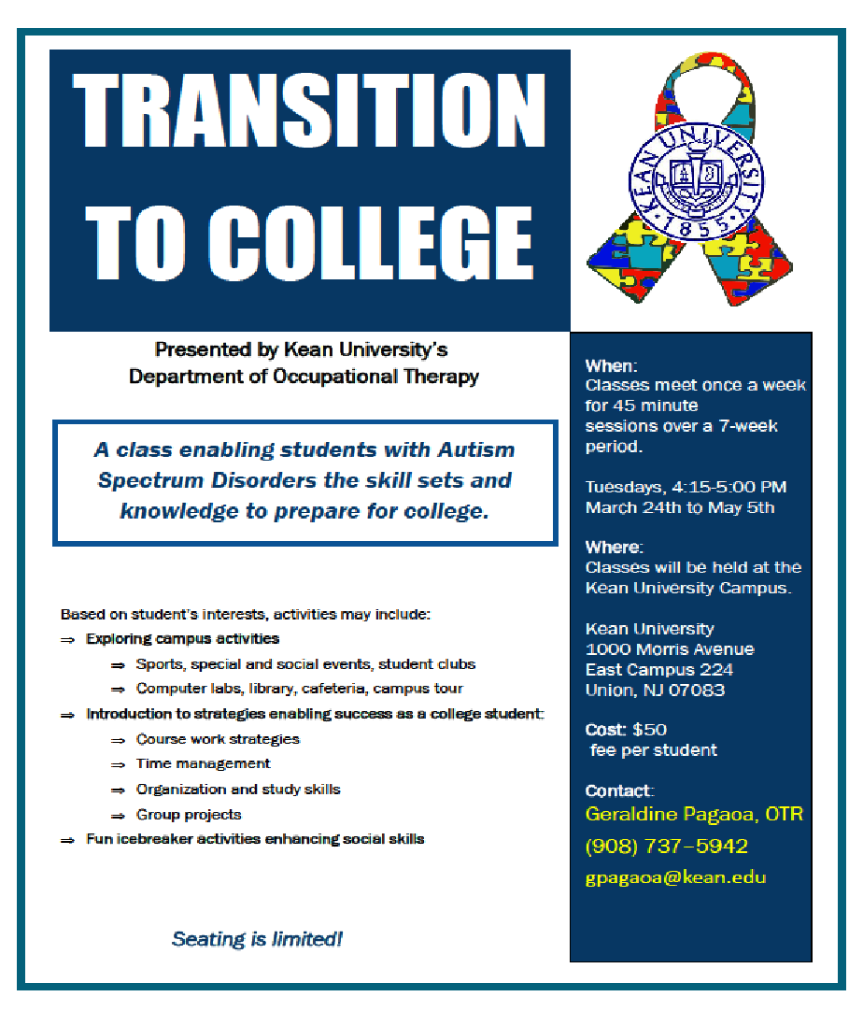
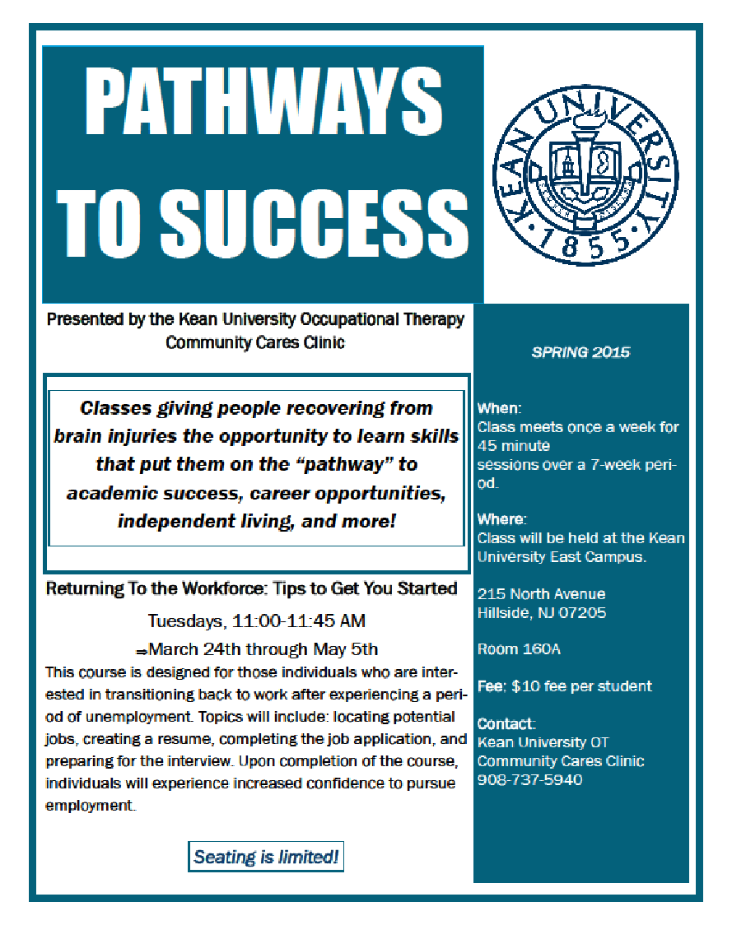

Slide 26
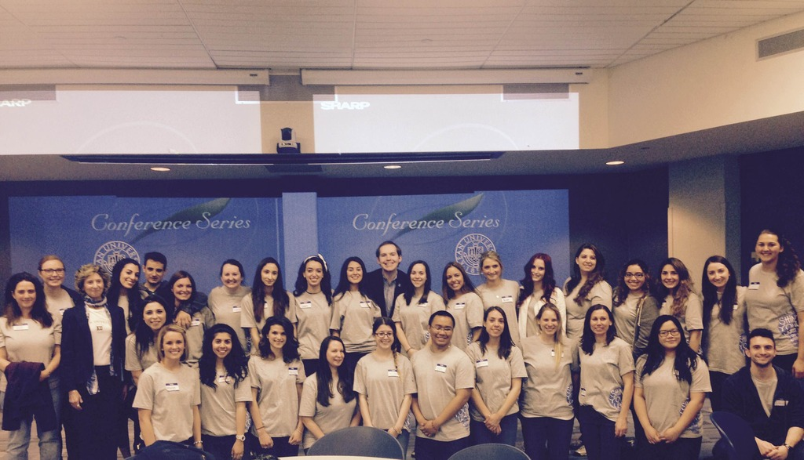
SOTA
Breakfast for Families Event

Slide 27
Thank you! Enjoy virtual
your day at
Kean University
Any questions about the program?
Students will stay around and talk to you more

Slide 28
Department Of Occupational Therapy
Latest News and Announcements for Prospective Students
https://www.kean.edu/academics/nathan-weiss-graduate-college/department-occupational-therapy
Email
OT@kean.edu

