Slide 1
President’s Task Force on Advising Recommendations
10/16/2023

Slide 2
Opening Remarks
President’s Task Force on Advising Co-Chairs
Dr. Joseph Youngblood, Senior Vice President of Transformational Learning and External Affairs
Dr. Mensah Peterson, Associate Vice President for Student Success and Retention

Slide 3
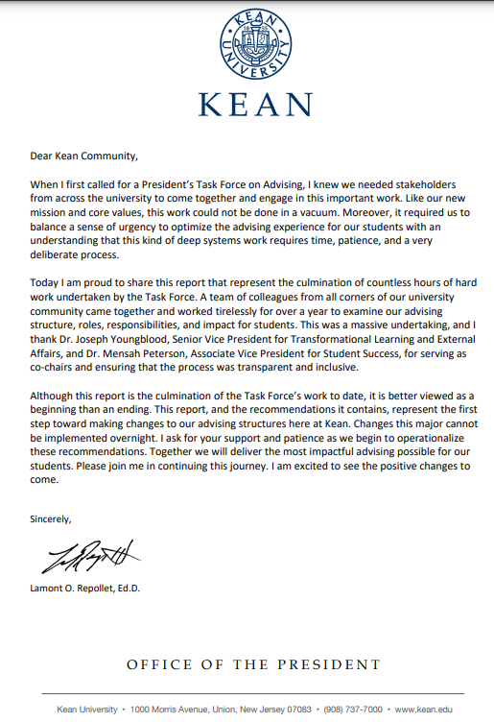
Opening Remarks

Slide 4
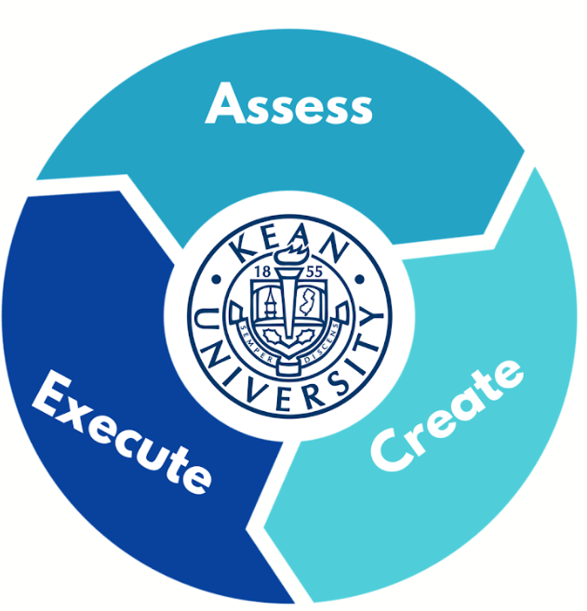
Opening Remarks

Slide 5
Purpose of the Task Force
Purpose
Facilitate communication and collaboration among Professional Academic Advisors and Faculty Advisors across the University.
Improve advising processes and practices across the University to improve student support.
Aid in the betterment of policies and procedures across the University as it relates to persistence, retention and student success at Kean.

Slide 6
Methodology/Approach
Steering
Committee
Survey
Content
Areas
Solicit
Campus
Community
100+
Members
The Charge

Slide 7
Kean University’s Mission
Kean University is a public cosmopolitan university serving undergraduate and graduate students in the liberal arts, the sciences, and the professions. The University dedicates itself to the intellectual, cultural, and personal growth of all its members — students, faculty, and professional staff. In particular, the University prepares students to think critically, creatively and globally; to adapt to changing social, economic, and technological environments; and to serve as active and contributing members of their communities.
Kean offers a wide range of demanding programs dedicated to excellence in instruction and academic support services necessary to assure its socially, linguistically, and culturally diverse students the means to reach their full potential, including students from academically disadvantaged backgrounds, students with special needs, and adults returning or entering higher education.
Kean is steadfast in its dedication to maintaining a student-centered educational environment in which diversity can flourish and an atmosphere in which mutual respect characterizes relations among the members of a pluralistic community. The University seeks to combine excellence with equity in providing opportunities for all students.
Kean is a teaching university, and Kean faculty dedicate themselves to student learning as well as academic rigor. The focus on teaching excellence is supported by a commitment to research, scholarship, creative work, and innovative uses of technology. The focus includes the advancement of knowledge in the traditional disciplines and the enhancement of skills in professional areas. Kean is committed to providing global educational opportunities for students and faculty.
Kean is an interactive university, and the University serves as a major resource for regional advancement. Kean collaborates with business, labor, government and the arts, as well as educational and community organizations and provides the region with cultural events and opportunities for continuous learning. Kean is also committed to providing students and faculty educational opportunities in national and international arenas.

Slide 8
Strategic Goals
Strategic Goals # 3 & 6
GOAL 3c: Provide faculty and staff with a broad range of professional development opportunities to continuously improve pedagogical practices and research skills and implement best practices to enhance the delivery of student support in and out of the classroom.
GOAL 3d: Create academic paths that meet student needs to ensure timely and successful completion of their academic programs.
GOAL 3e: Create attractive and engaging retention campaigns, treating current students much like prospective students and ensuring that their financial aid, housing issues, and other needs are addressed on an ongoing basis.
GOAL 6a4: Create effective collaborations between university divisions so that all members of the university community take ownership of recruitment, retention, and student support.

Slide 9
National Academic Advising Association

Slide 10
Methodology/Approach
Most Important Constituents (Kean University Students)
Megan Engels
Graduated from Kean University May 2023
Bachelor of Arts in History (Honors; P-12)
Glynnis Tan
Senior
Major: Global Business

Slide 11
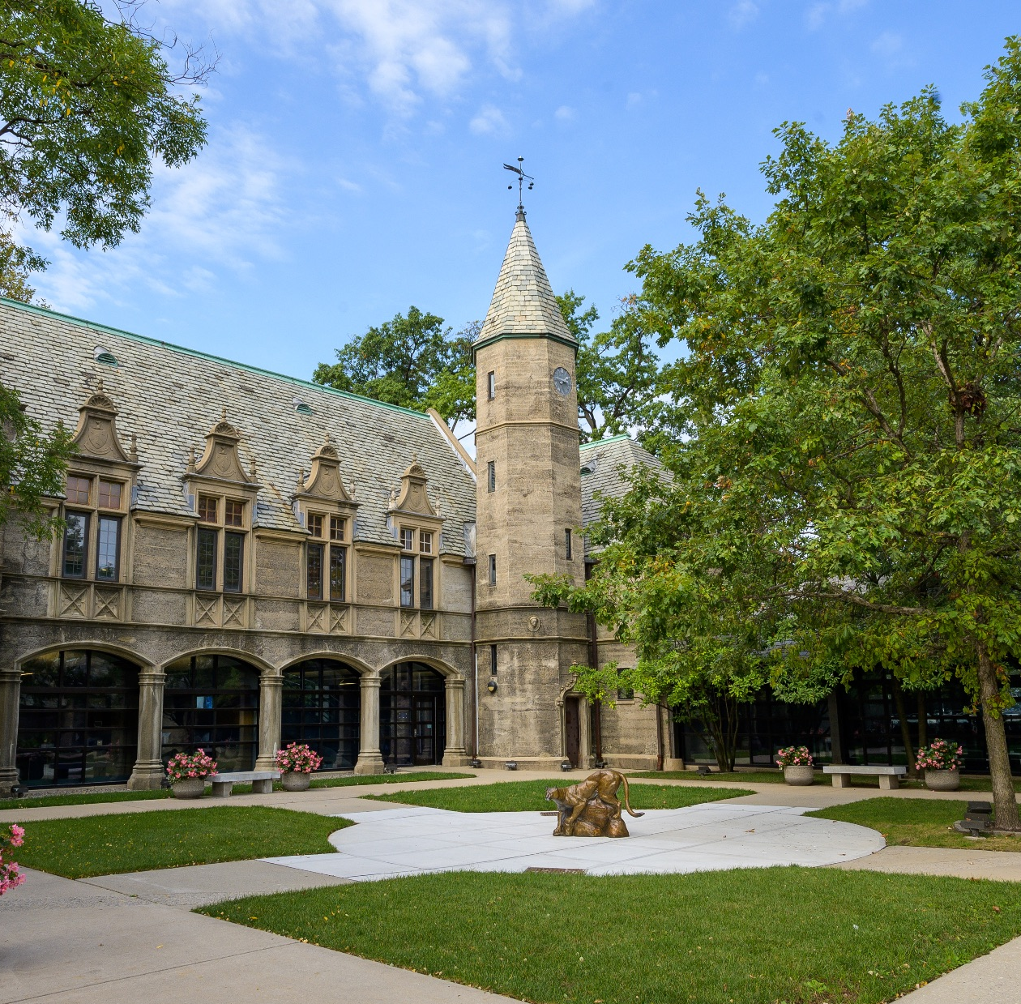
5 Content Areas
Advising Structure and Model
Advising Communications
Advising Policies and Procedures
Technology and Assessment
Advisor Training

Slide 12
Advising Structure and Model
Co-Chairs
David Farrokh,
Assistant Dean, College of Business and Public Management
Vito Zajda,
Director, Center for Veterans Student Success

Slide 13
Advising Structure and Model
Recommendation #1 Ensure Equitable and Accessible Advising Delivery
Recommendation 1.A. All new, incoming undergraduate students (freshmen and transfers) should receive academic advising upon their entry into the institution by the Center for Advising, Persistence and Success (CAPS) staff of professional advisors. Students will be assigned a faculty advisor once they earn 60 credits.
Recommendation 1.B. Students admitted through Special Admission programs, including SUPERA, EOF, Bridge to Success, and Center for Veteran Student Success will be assigned a program advisor/counselor at the University, in their program, who will remain with the student throughout their undergraduate career at Kean. These student populations are not assigned a CAPS advisor at all, but will be assigned a faculty advisor once they earn 60 credits.

Slide 14
Current Advising Structure and Model
School of General Studies (Incoming Freshmen Students)
Admissions and Academic Departments (Incoming Transfer Students)
CAPS (Continuing Students between 0-59 credits)
Faculty Advisor (Continuing Students between 60-120 credits)

Slide 15
Recommended Advising Structure and Model
CAPS
Incoming Freshmen Students
Continuing Students between 0-59 credits
Incoming Transfer Students
CAPS (Continuing Students between 0-59 credits)
CAPS (Continuing Students between 0-59 credits)
Faculty Advisor (Continuing Students between 60-120 credits)
Faculty Advisor (Continuing Students between 60-120 credits)

Slide 16
Advising Structure and Model
Incoming and Continuing Freshmen Resource Implications:
Assuming an annual incoming freshman class of 2,000 students to advise.
Assuming the continuing freshmen population, generally, remains around 1,200 students for CAPS.
CAPS would require approximately 13 more full-time professional advisors and 1 additional Associate Director responsible solely for Incoming First Year Students.
The additional staff request is based on national data for effective student caseloads (250:1; 300:1) endorsed by the National Academic Advising Association, (NACADA), the premier professional organization in this area.

Slide 17
Advising Structure and Model
Incoming and Continuing Transfer Student Resource Implications:
Based on the NACADA recommended caseloads, CAPS would require, minimally, seven additional full-time professional advisors to serve new and continuing transfer students.
This conclusion is borne out by end-of-recruiting cycle admissions data reporting large numbers of transfer students who have been neither advised nor registered for classes. Enrollment Services estimates an additional 400 students would have enrolled through better operational efficiency for Fall 2022 alone.

Slide 18
Advising Structure and Model
Recommendation 1.C. Major programs with highly structured, cohort-guided operations may opt to advise their students upon entry until graduation.
Recommendation 1.D. All undergraduate students with an intended or declared major have a faculty advisor assigned upon earning 60 or more credits.
Recommendation 1.E. Further enhance, recognize, and support the Center for Advising, Persistence, and Success (CAPS) as the University’s advising hub.
Recommendation 1.F. Centralize training for all advisors (faculty, professional, and program) provided annually and regularly to promote consistency, clarity, and collegiality.
Recommendation 1.G. The New Student Orientation (NSO) will continue to be coordinated by the Division of Student Affairs. However, should incorporate tenets of academic advising and its importance on their pathway to completion.
Recommendation 1.H. Undecided students will be advised by a CAPS professional advisor. In accordance with a revised Declaration of Major practice, students will select an intended major by the time they have attempted/earned 45 credits at Kean University. All students are assigned a faculty member once they have earned 60 credits.

Slide 19
Advising Structure and Model
Further Consideration
Further investigation of structure and staffing at the Kean Ocean campus is needed. While this report was addressing the advising structure and needs for the main campus, the consideration of equitable needs of Kean Ocean should be addressed and reviewed. The above recommendations will serve as a guide and will be shared during implementation with leadership as a springboard for forming such guidelines.
As modifications are made to the existing structure, the University should regularly assess the efficacy of advising delivery across the institution.
As the population of students admitted to the School of Online Education grows, the advising structure may be impacted.
Improve the efficiency and timeliness of completion of transfer credit evaluations.

Slide 20
Advising Communications
Co-Chairs
Dr. Patrick Ippolito,
Associate Professor, College of Education
Jeremiah Sullivan,
Acting Director, Academic Partnerships and Career Curriculum

Slide 21
Advising Communications
Recommendation #2 Provide clear lines of communication of academic advising practices to University constituents (i.e. students, faculty and staff).
Recommendation 2.A. The institution should utilize one advising platform to ensure that there is less confusion for institutional constituents regarding advising and registration.
Recommendation 2.B. Determine what students’ preferred method of communication is and needs to be when disseminating and sharing essential academic advising information.
Recommendation 2.C. Ensure that advising practices and processes are clearly communicated to students at the University.
Recommendation 2.D. Establish transparent ways to communicate how students can resolve issues, concerns or problems.

Slide 22
Advising Policies and Procedures
Co-Chairs
Viviana Zambrano,
Associate Director, Office of Student Retention and Educational Innovation
John Van Brunt,
Assistant Vice President, Admissions

Slide 23
Advising Policies and Procedures
Recommendation #3 Ensure that the policies, procedures and practices are equitable, student-centered and look to increase student outcomes.
Recommendation 3.A. Ensure, a University-wide, use of academic plans are established for all students, through the institutional advising platform.
Recommendation 3.B. Streamline and enhance the Satisfactory Academic Progress (SAP) processes at Kean University.
Recommendation 3.C. Improve the Declaration of Major policy and procedures to improve student outcomes and degree completion at Kean University.
Recommendation 3.D. Enhance the Kean University Leave of Absence (LOA) process by providing students with a more comprehensive and accommodating system that meets their diverse needs.

Slide 24
Advising Technology and Assessment
Co-Chairs
Dr. Elizabeth Hyde,
Acting Associate Dean, College of Liberal Arts
Dr. Rebeccah Newman,
Former Director, Academic Affairs

Slide 25
Advising Technology and Assessment
Recommendation #4 Overhaul all advising technologies and platforms to provide easy access to necessary curriculum and student support information.
Recommendation 4.A. Ensure that the EAB Navigate platform breaks down many of the administrative hurdles to provide clear, consistent and easily accessible information about students seeking and needing advisement, registration, and other support services.
Recommendation 4.B. Curriculum software and degree audits (either through Student Planning and or Navigate) MUST be able to track student majors AND minors as a matter of equity for Kean students and to accommodate pending curriculum revisions.
Recommendation 4.C. Kean must assign oversight and or periodic program review/assessment of End User technologies to a single entity/stakeholder to ensure they meet the above stated goals.
Recommendation 4.D. Overhauled technologies and functionalities must be accessible through a single portal or landing page with the following functionalities, essential to the End Users (our students and their advisors), as outlined in the Table on the following page.
Recommendation 4.E. Consider the models for the assessment of advising by following NACADA’s assertion that advisement is part of the educational experience. To that end, assessment should be modeled on academic assessment in assessing what students know, what they do, and how they value advising. More specifically, we need to assess:

Slide 26
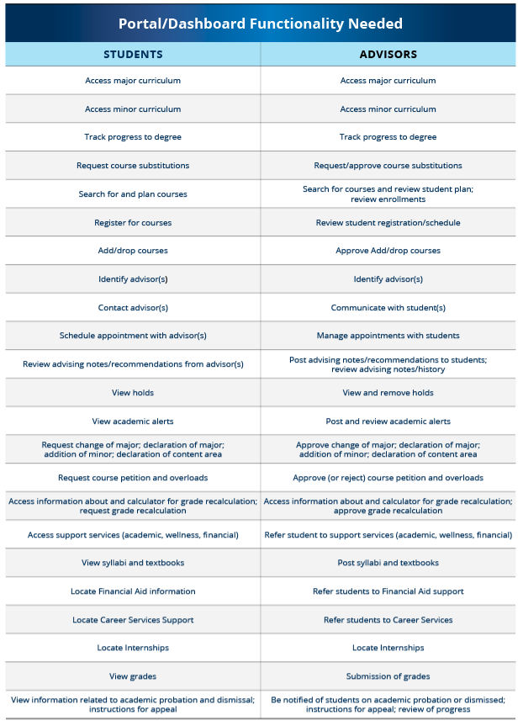
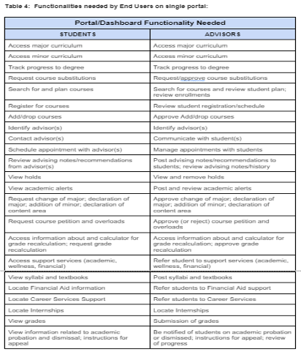
Portal/Dashboard Functionality Needed

Slide 27
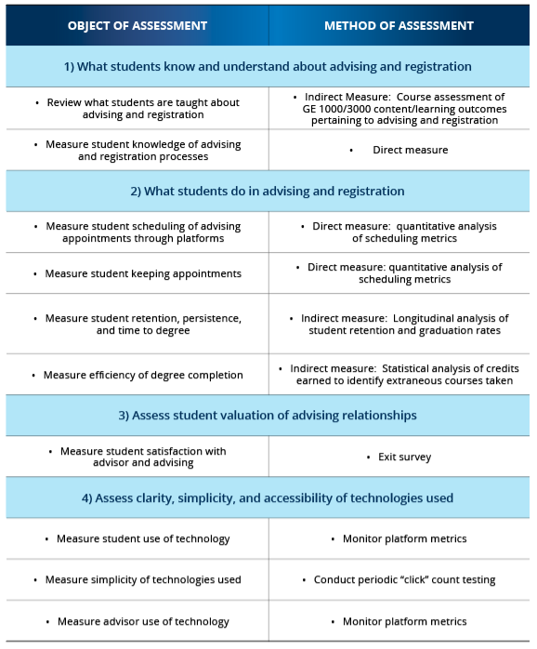
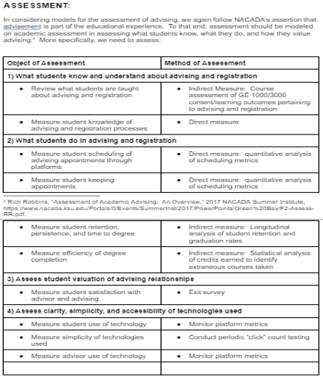
Assessment
In consider models for the assessment of advising, we again follow NACADA’s assertion that advisement is part of the educational experience. To that end, assessment should be modeled on academic assessment in assessing what students know, what they do, and how they value advising¹. More specifically, we need to assess:

Slide 28
Advisor Training
Co-Chairs
Rosa Paulino,
Director, SUPERA, The Spanish Speaking Program
Dr. Franklin Turner,
Coordinator, Marriage and Family Therapy Program

Slide 29
Advisor Training
Recommendation #5
Provide advisors with a standardized advisor training program and opportunities to gain certifications to develop the knowledge and skills needed to help students persist to graduation at Kean University.
Recommendation 5.A. The advisor trainings should have different modalities in which advisors learn from.
Recommendation 5.B. An assessment component should be developed for the advisor training program. This would allow the professional development opportunities to be assessed for effectiveness. The assessment can be part of the current yearly evaluations for professional advisors “to assess the understanding of various job duties, set goals, and evaluate any changes that need to be made”. Faculty advisor assessment would need further discussion.
Recommendation 5.C. Prizes and rewards should be incorporated into the training to incentivize advisors to learn and professionally develop.
Recommendation 5.D. We also recommend that a training manual or advisement handbook be developed as well as an online repository to house subject specific trainings. A process for updating the handbook needs to be implemented to ensure that it is kept current and relevant.
Recommendation 5.E. An extension of a university committee on advisement should be created, with representatives from different colleges and units who will be responsible for providing updates and recommendations. In addition, the new Center for Teaching and Learning can assist with developing or recommending training materials and modules guided to faculty.

Slide 30
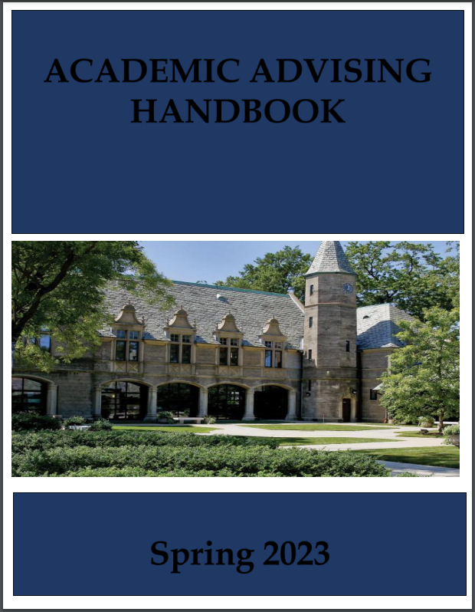
Advisor Training

Slide 31
Implementation Phase
Next Steps
Itunu Balogun,
Deputy Chief of Staff, Office of the President

Slide 33
Implementation Phase
Next Steps
Dr. David Hood,
Provost and Senior Vice President, Minnesota State University, Mankato

Slide 34
QUESTIONS?

Slide 35
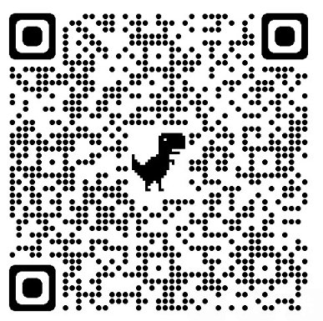
Feedback Form
https://www.kean.edu/presidents-task-force-advising

