Slide 1

Criminal History Record
Check and Fingerprinting

Slide 2

Criminal History Record Check and Fingerprinting
Office of Student Placement
& Clinical Experiences
Notes:
Hello! Thank you for taking the time to view this presentation on the NJ Criminal History Record Check and Fingerprinting process. We have created this presentation to assist with this process and hope you will find it useful. This presentation will contain a lot of useful information that you will need each semester. We suggest you print out the PowerPoint presentation to follow along and take your own notes as needed. Remember to pause the presentation at any time to complete steps and procedures or just to take a minute to process the information. This is self paced and for your understanding. Should you continue to have any questions or require additional information after viewing this, you can reach out to Kean’s Office of Student Placement and Clinical Experiences at coepo@kean.edu. Let's get started.

Slide 3

What You Need for Scheduling
The Fingerprinting Appointment
Driver’s License
Social Security Number
Debit/Credit Card for Payment
Notes:
These are the items that you will need to complete the criminal history record check process. If you don't have them accessible at this time, pause this presentation so you can gather them. If you are not in a place where you can access this information, come back to the presentation at a place and time when you have all of this. Please note: it is important you double check your social security number and ensure it is correct. The system you use for this process will be used through the NJ Department of Education throughout your career as an educator in NJ. Inputting accurate information the first time will be very helpful in eliminating account issues moving forward.
Once you have all of the information and paperwork required, come back and resume the presentation.

Slide 4
Process…
TODAY
File for criminal history record check & schedule the fingerprinting. Payment will be required at this time.
Fingerprinting Appointment
Attend your fingerprinting appointment; bring your IDENTOGO NJ Universal Fingerprint form with you
Obtain Approval
Continuously check the office of student protection website for access to approval (this can take up to 2 weeks);
*you will not receive a confirmation, you MUST check
Send approval to Kean’s Office of Student Placement and Clinical Experiences
As soon as approval has been obtained, send a copy to coepo@kean.edu
*Transfer to District: Each time you start at a new district you must transfer your background information to them. This includes your first placement; your form should show that it was sent to Kean University and your placement. There will be a separate training specifically going through the steps for transferring to a new district.
Notes:
Here we see an overview of the steps needed to complete the background approval process. To start, you will need to file your criminal history record check and schedule your fingerprinting appointment. Two weeks after your fingerprinting appointment you will have access to your approval. Please be aware that this isn't something you will be notified about; you must look for it yourself by returning to the Office of Student Protection website. After the approval has gone through you must transfer it to your district. Transferring to your district is a process that you will have to complete each semester. There will be a separate PPT to provide guidance for that. It is important for you to recognize and remember this step for each semester/placement you are in the field. Please be sure that you understand how to do so and if you have any questions about the process reach out to our office early on so that we can assist you in getting to your placement as soon as possible. After each transfer, you will return to the site to download your updated approval and then send it to our office.
One question often asked is "why do I need to send this to Kean University first if I only have to transfer the approval to another district anyway? The answer is that the process to receive a Criminal History Record Review Approval can take up to several months. Sending the process to Kean allows students to complete the process before a placement district is known. The transfer process only takes a few days. Having the approval completed ahead of time eliminates frustration on the student's part and prevents unnecessary delays in starting your placement.
As an overview, it helps to think about the whole process and the steps required. Ultimately, you want to receive your Criminal History Record Review Approval Certificate. In order to receive that, you need to provide the information and payment for the Criminal History Record Check to be completed, schedule and have your fingerprints taken so the background check can be run and then obtain/retrieve the Criminal History Approval.
This presentation will walk you through the steps under 'today' - filing for your criminal history record check and scheduling your fingerprinting appointment.

Slide 5
Filing for
Criminal History
Record Check
Notes:
We are going to start with filing for your Criminal History Record Check by using Kean University as your current district/place of employment. Once you have completed this process to Kean University, you will need to transfer your approval to your actual district of placement. You will need to transfer your approval prior to going out for each placement. Note that you may have completed background checks in the past for other positions (such as a volunteer, teacher's aide, etc.), however, if you did not complete it as a substitute teacher you will likely have to initiate this process again.
If you want to confirm if it's necessary, you can email Kean’s Office of Student Placement and Clinical Experiences at coepo@kean.edu to seek help determining if any previous approval can be used.

Slide 6
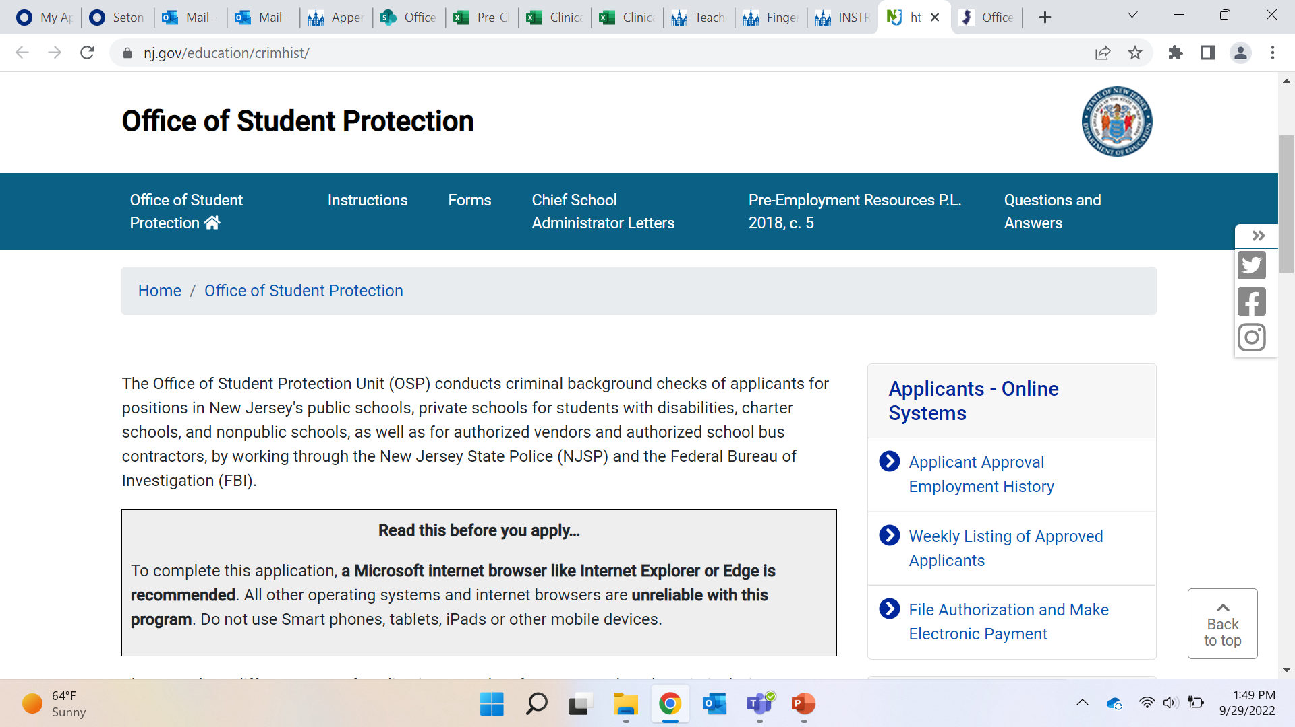
Go to the Office of Student Protection website by clicking this link: https://nj.gov/education/crimhist/
Once at the site…
Click here
Notes:
Ok, let’s get started! You will need to go to the website for the Office of Student Protection, you can access this at the link at the top of the slide. The address is https://nj.gov/education/crimhist/. Once there, you will want to click on "File Authorization and Make Electronic Payment" which the arrow is pointing to on the slide. Don’t forget, you can pause the presentation at anytime to gather items needed, take notes, or to make sure you are in the right place.

Slide 7
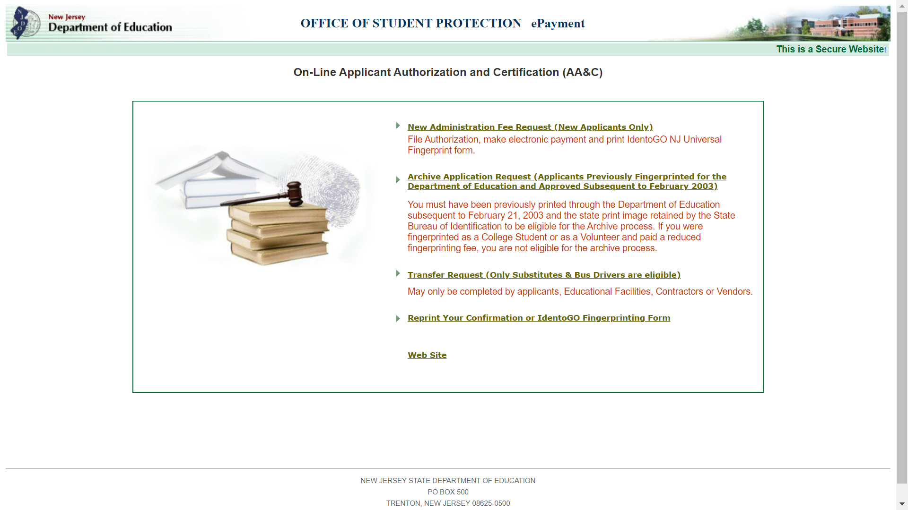
Once at this page, you will
need to file authorization
To file authorization
Click here
Notes:
After choosing 'File Authorization and Make Electronic Payment', you will see the screen shown here. On this page you will select the link that states, "New administration fee request (new applicants only)," as pointed to with the blue arrow on the slide here. It is the first option in the list on the page. As a reminder, pause this training at any time if you need to gather documents or need to review the information just presented.

Slide 8
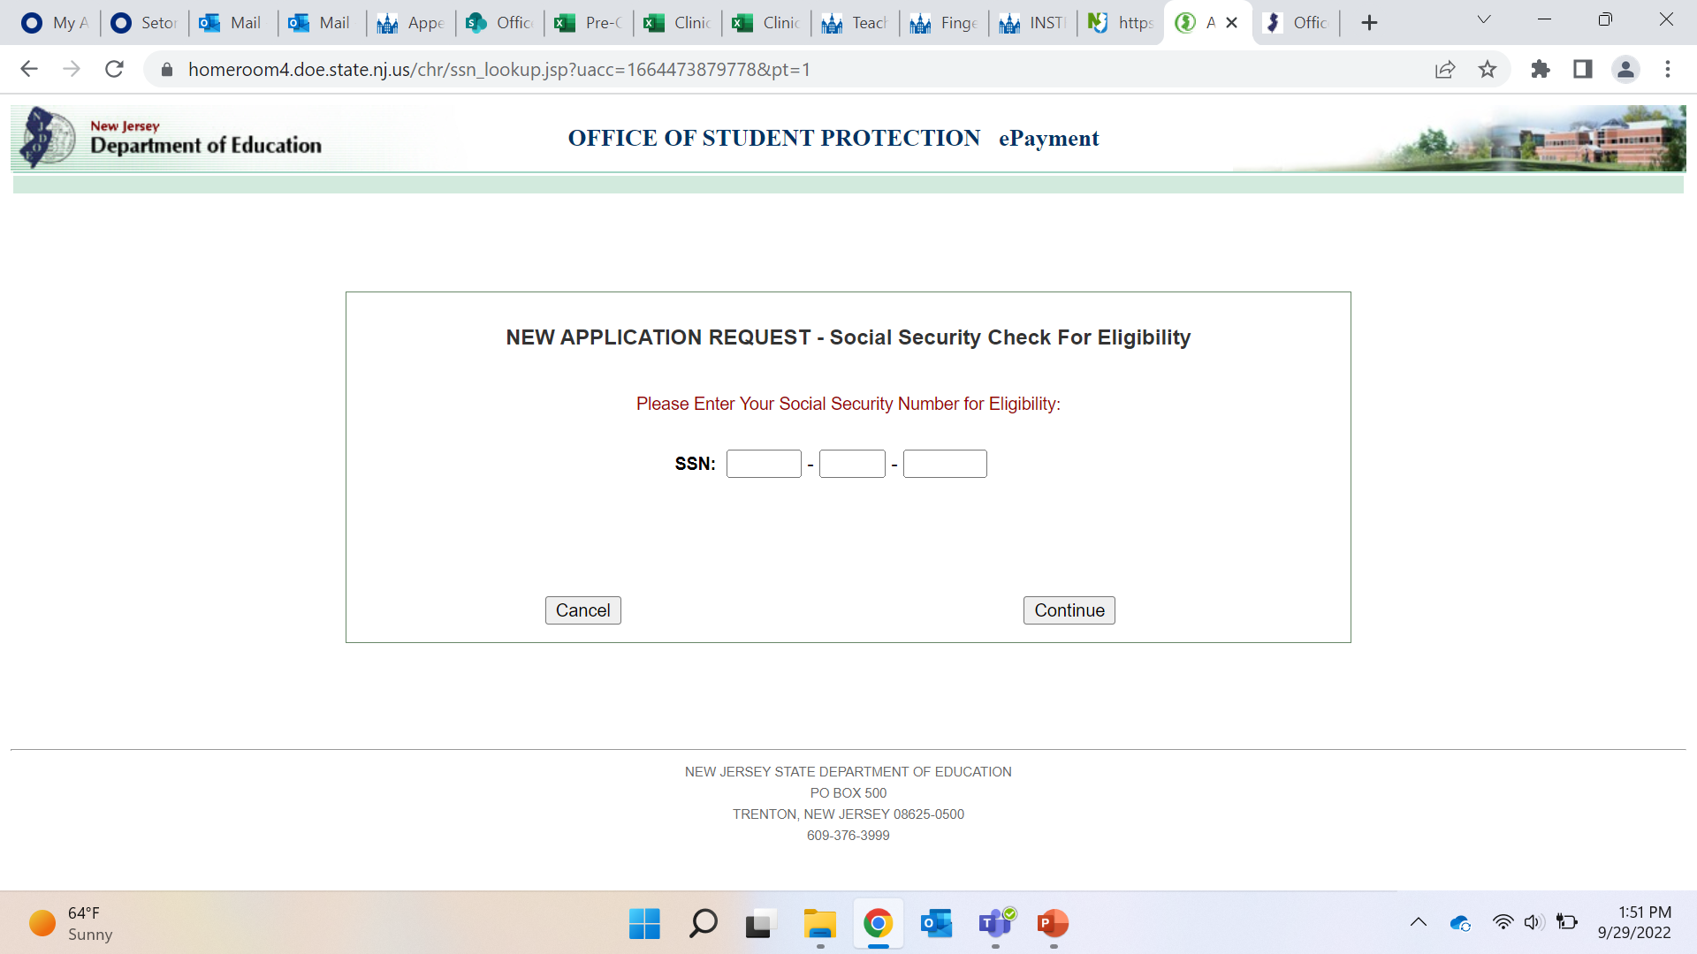

After filing authorization,
enter social security #.
Be sure to double and triple check the number you enter is correct…
Notes:
After clicking the link from the prior slide, you will be directed to this page. Here you will enter your SSN. Please be sure to enter it correctly. Remember, that completion of this process creates an account you will use your entire career, not just for placements. Proper input of the social security number is critical. This is the identifier for your application. If you enter it incorrectly, there will be difficulties reconciling your account and addressing any issues moving forward. Please review the number carefully!

Slide 9
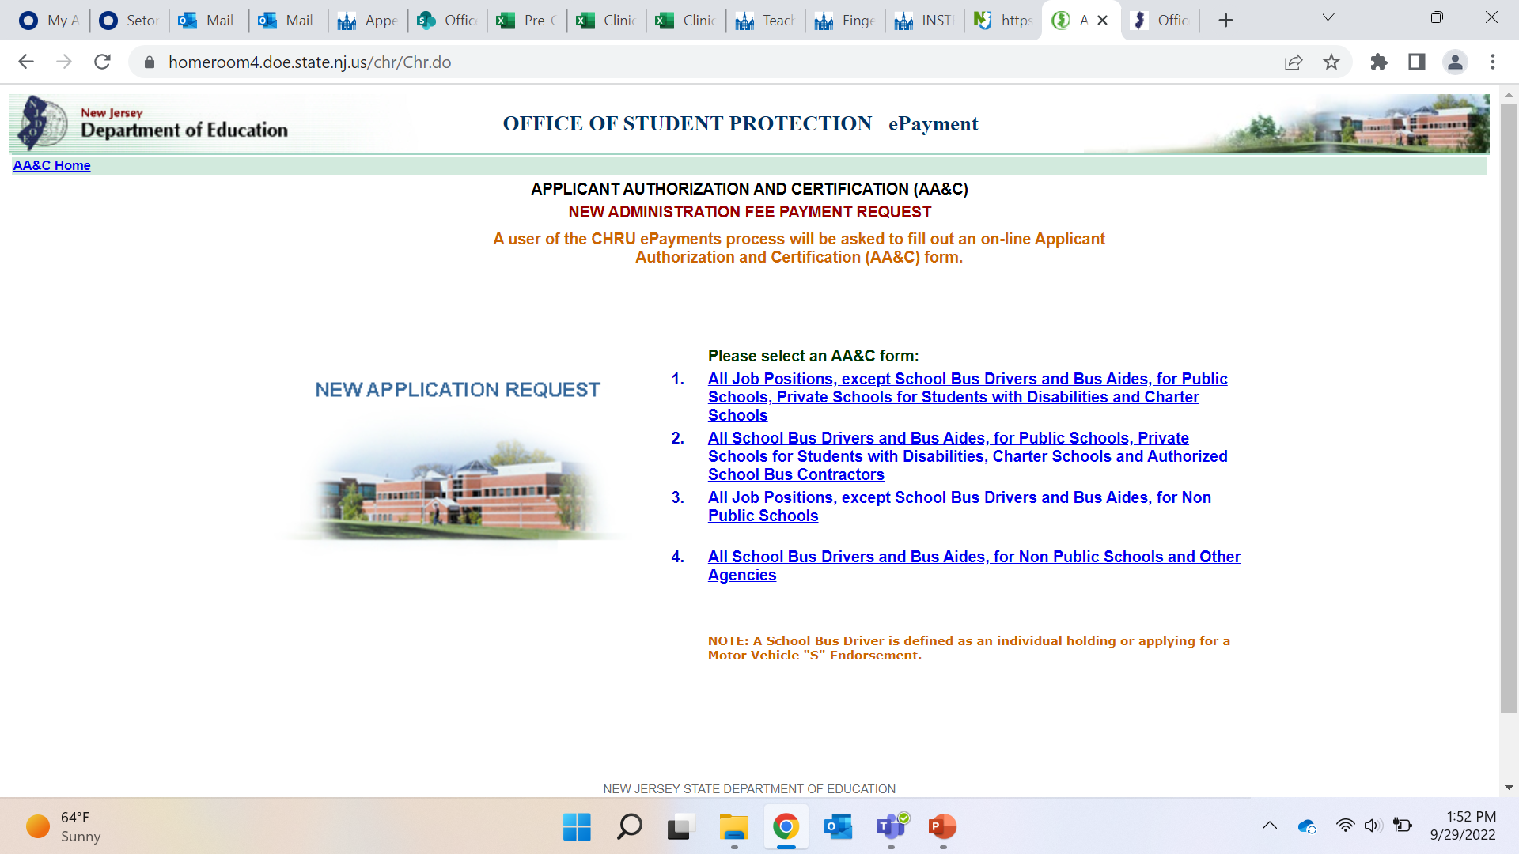
At this site you will need to select
“all job positions…”
Click the first option here…
Notes:
After entering your SSN, you will be brought to this page where you will select "All job positions, except school Bus Drivers and Bus Aides for Public Schools, Private Schools for students with Disabilities and Charter Schools," It is pointed to by the blue arrow on the slide and is the first choice out of the four listed on the page. Click here now.

Slide 10
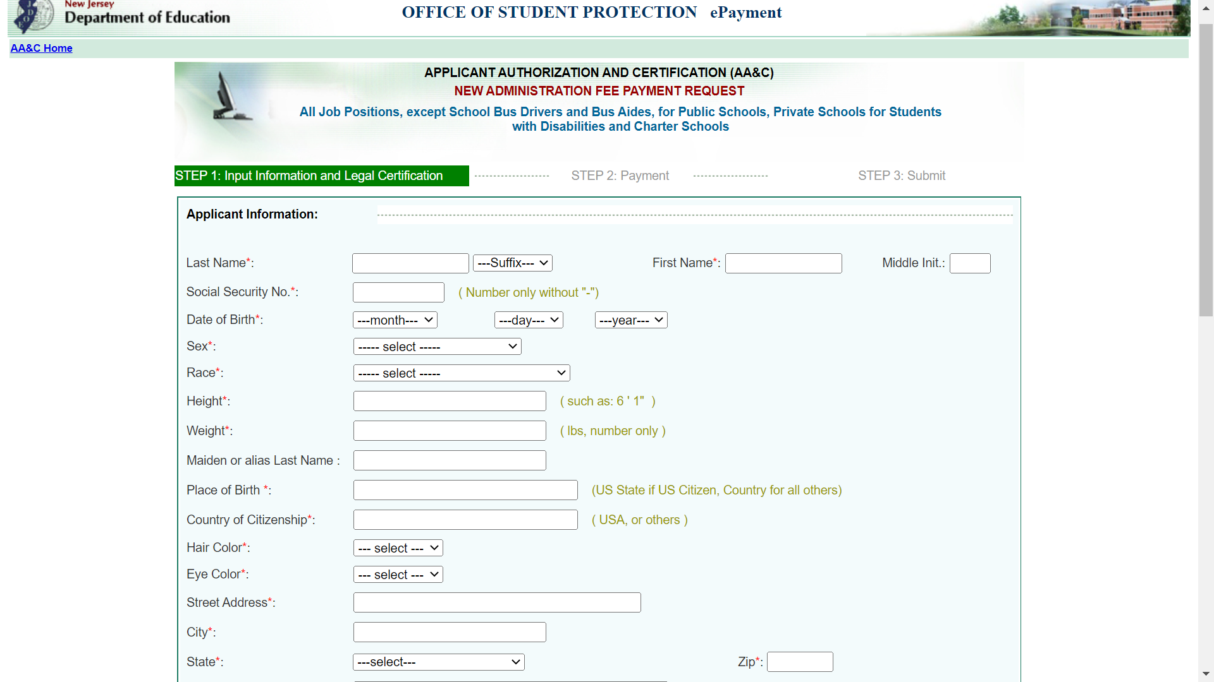
Fill out the required information
Use your FULL,
LEGAL NAME (what’s on your passport and/or license).
Double check
your SS# entry!
Notes:
The selection of the "all positions" option, brings you to this page to fill in your personal information. Please be sure to enter all your information correctly. The name used in this form should be the name that appears on your government issued documents. Do not use any nicknames or shortened versions of your name. Again, you will want to ensure that your SSN has been input correctly.
You will want to pause this presentation in order to complete your personal information. The bottom of this page will ask you to enter the job category, and sponsor codes. When you get to that point on the screen, come back and resume the presentation.
Be sure to use an email address you will continue to use and have access to when you leave Kean University and enter your teaching career. You will not have access to your Kean email after graduation.

Slide 11
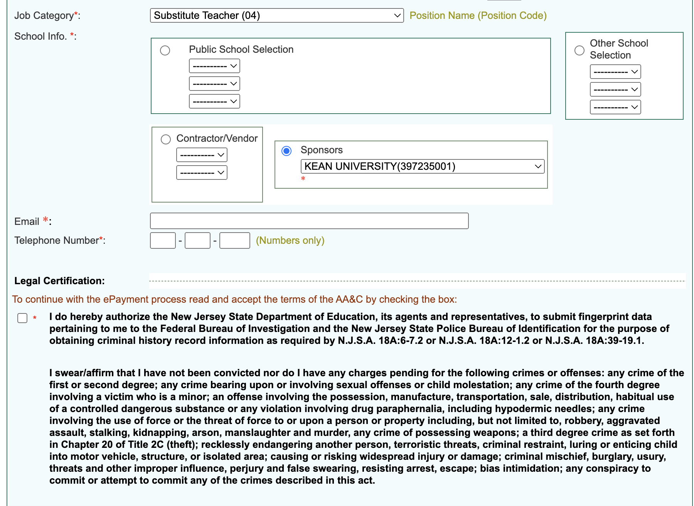
Be sure to use the correct codes
to send to Kean University
Enter the following information:
Job Category:
Substitute Teacher (04)
Sponsor:
Kean University (397235001)
Email:
Use a personal email, NOT KEAN, so you have access after you graduate.
Notes:
Welcome back from your pause.
Near the bottom of the information form you have come to the point where you need to input your job category and public-school selection. Be sure to input "Substitute teacher (4)" as your job position. Any other positions you may have had in the past (such as volunteer, or teacher's aide) will not allow you to transfer the approval. You need to choose substitute teacher. Under the public-school section, you will want to put Kean University’s information as listed on the slide. For your email address, please do not use your Kean University email address. You will want to use a personal email address that you have access to after leaving Kean University. Double check that you have entered all your information in the form correctly before you complete this section.

Slide 12
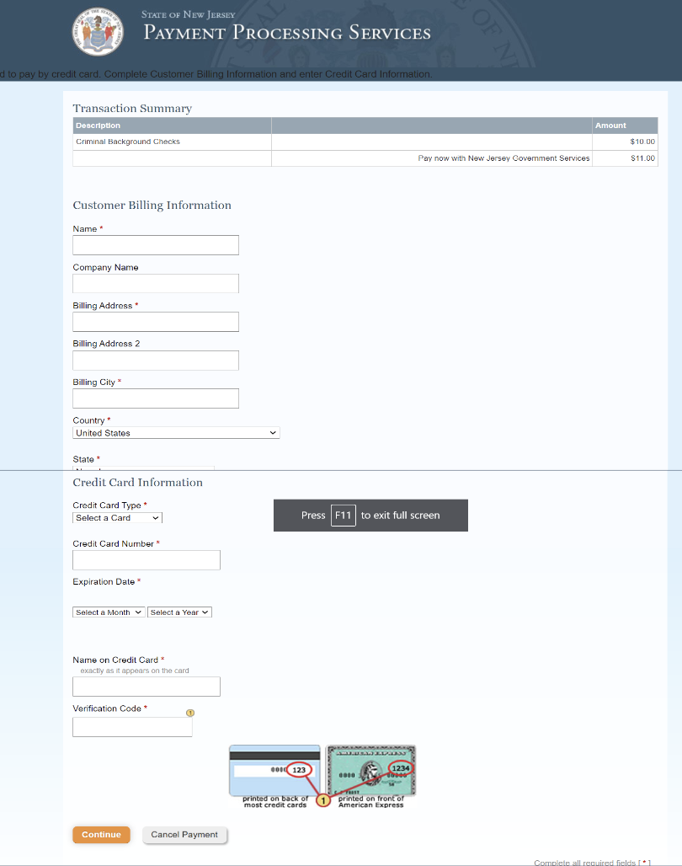
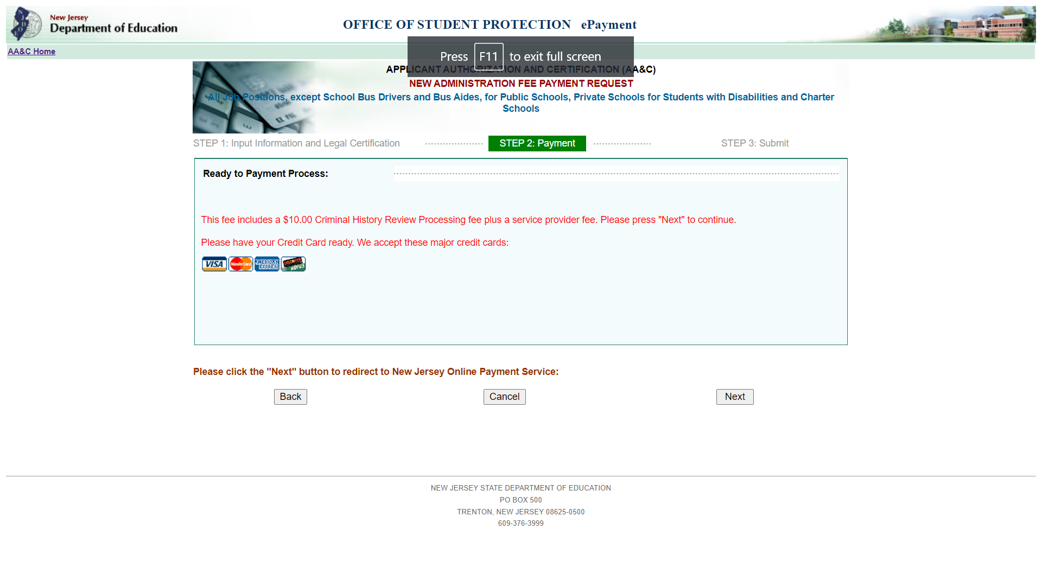
To Complete
Payment: Click next.
Then you will come to this page…
Complete all entries and enter payment info. Then click confirm.
Notes:
Once you have finished filling out your information you will be prompted to complete payment. Again, you will need to click the "next" button at the bottom of the page. This will bring you to an online payment service.
In the online payment service you will need to input your information. Review the screenshots here. Pause the presentation here until you have had the opportunity to complete the payment information requested. This is where you will need the credit card you gathered earlier. Be sure to hit "continue" to complete the payment.

Slide 13
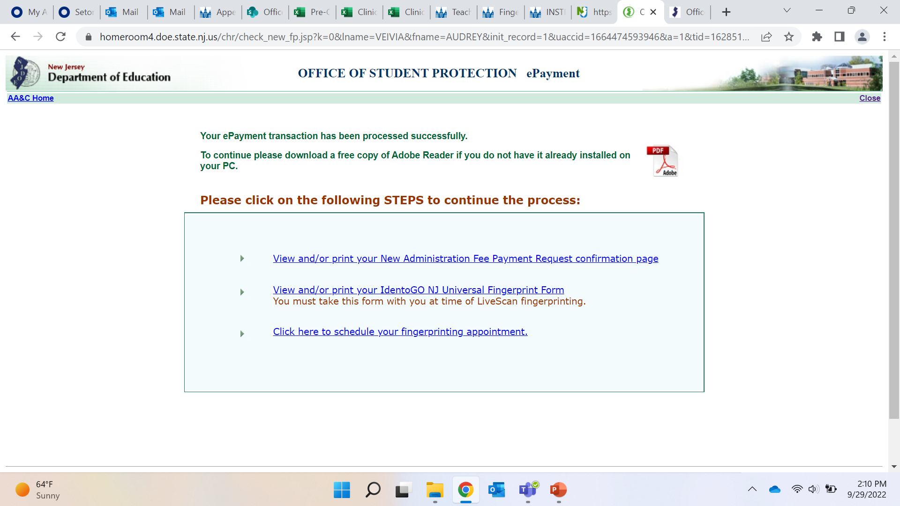
Complete each of the following steps, by clicking each link.
Notes:
After payment is complete, you will be brought to this page confirming that your payment went through. This page provides three steps/links that you must complete in order to continue through the criminal history record approval process. You must complete all three steps by choosing each link, in order. The first link will provide you with your receipt for the fee payment. The second will allow you to access your fingerprint form which you will need to bring to your fingerprinting appointment, and the last link will allow you to schedule your fingerprinting appointment. We will go through each of the links on the next slides.

Slide 14
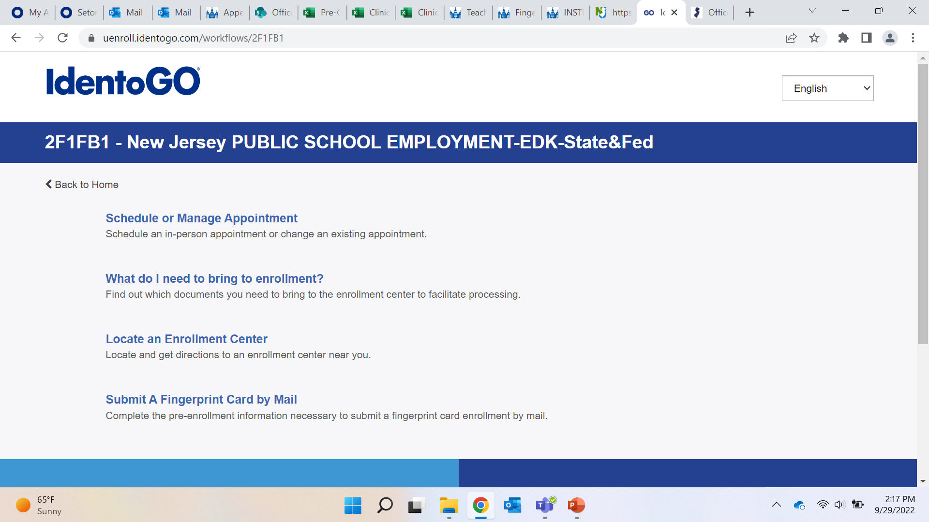
Previous Slide Reminders…
View and/or print your New Administration Fee Payment Request confirmation page
Print/screenshot a copy of the receipt, or save as a PDF on your computer for your records.
Print/screenshot the IdentoGO NJ Universal Fingerprint Form
Reference this form when scheduling your appointment.
Click here to schedule your fingerprinting appointment with Idemia
Notes:
Here are the specifics on the three links from the previous slide.
It’s important to keep a record of the new administration fee payment request confirmation page. You do not have to submit this to anyone, but please print or take a screenshot and save somewhere safe, or save as a PDF on your computer.
Print/screenshot, or save as a PDF the IdentoGo NJ Universal Fingerprint Form. You will need to reference this when scheduling your appointment.
From this original page of three steps/links, you will select the final link to schedule your fingerprinting appointment. Once you have clicked the link you will be directed to the page pointed to here with the blue arrow. Once there, you can click on "schedule or manage appointment" to schedule your fingerprinting appointment. You can also access valuable information on this site for your fingerprinting appointment. It’s highly recommended you read through the "what do I need to bring to enrollment" to make sure that you are well prepared and don't have any issues at your appointment. Once you have scheduled your fingerprint appointment, please notify the Kean’s office of Student Placement and Clinical Services the date of your scheduled appointment. This helps us ensure you are moving through the process. If for some reason, your appointment date needs to change, please notify us of that change. Be sure to put the appointment on your calendar, in your planner, in your phone, or wherever you need to put it so you do not miss the appointment! As you'll see, the scheduling can be a few weeks out and we don't want missing this appointment to be a reason for delaying placement.
Please go ahead and pause this presentation until you have scheduled your appointment and marked it on your calendar.

Slide 15
Approval is approximately
2 weeks after your appointment
Return to the
Office of Student Protection website
https://www.nj.gov/education/crimhist/
You will NOT receive a confirmation email once your fingerprints have been approved.
It is your responsibility to check regularly for approval
Select Applicant Approval Employment History on right hand side of page
Enter your social security number and birth date to view the status of application.
SCREENSHOT
AND PRINT
Applicant Approval Employment History Form
Notes:
At this point, you are either continuing on with the whole presentation to become familiar with the steps you'll need to follow in a few weeks OR you have completed your criminal history record check, put a two week reminder on your calendar and are back to retrieve your approval. About 2 weeks after you have been fingerprinted your approval will be processed. The Office of Student Protection will not tell you when it is ready, it is your responsibility to check for it on their site.
You will need to go back to the Office of Student Protection website that is posted here. ( https://nj.gov/education/crimhist/.) From here, you will choose 'Applicant Employment History', be asked to enter your date of birth and social security number and see if it your approval is ready. If it is ready, screenshot and print for your record, or you can create a PDF and save to your computer.
PLEASE NOTE: If you see any message or error that indicates there is a problem with your approval indicating it can't be processed, you MUST contact the office of student protection. Some data or information is incorrect and it needs to be investigated by their office. Do not wait and assume it will correct itself when you check back.

Slide 16
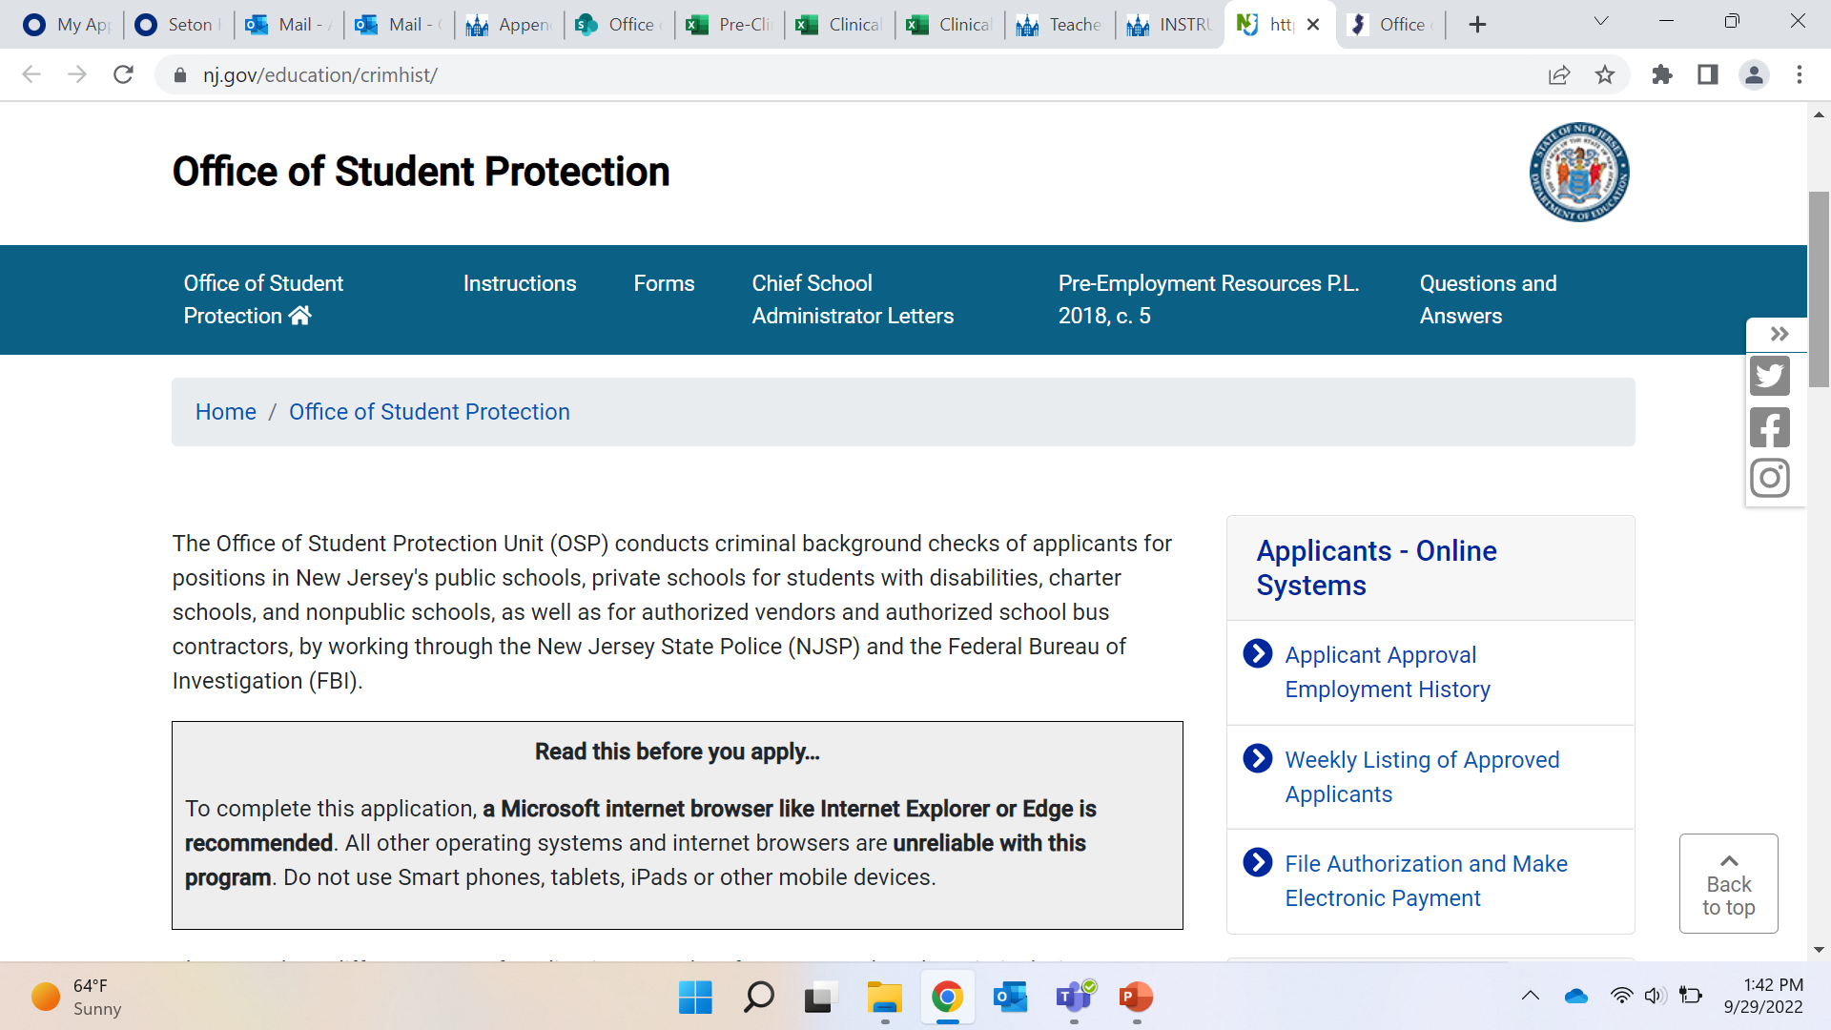
Go to Office of Student Protection and click “Applicant Approval Employment History”
Notes:
As indicated on the previous slide, once on the Office of Student Protection website, you will select "applicant approval employment history.” You will be prompted to enter your date of birth and social security number.
If your approval has been processed, you will be able to click a link to see the PDF. If there is nothing there, you should set another reminder in your calendar to check in a few days. Typically, the office uploads state approvals on Monday and Thursday evenings. Any other message on the screen, requires you to reach out to their office for assistance.
Again, feel free to pause the presentation until you have been able to enter and complete these steps.

Slide 17
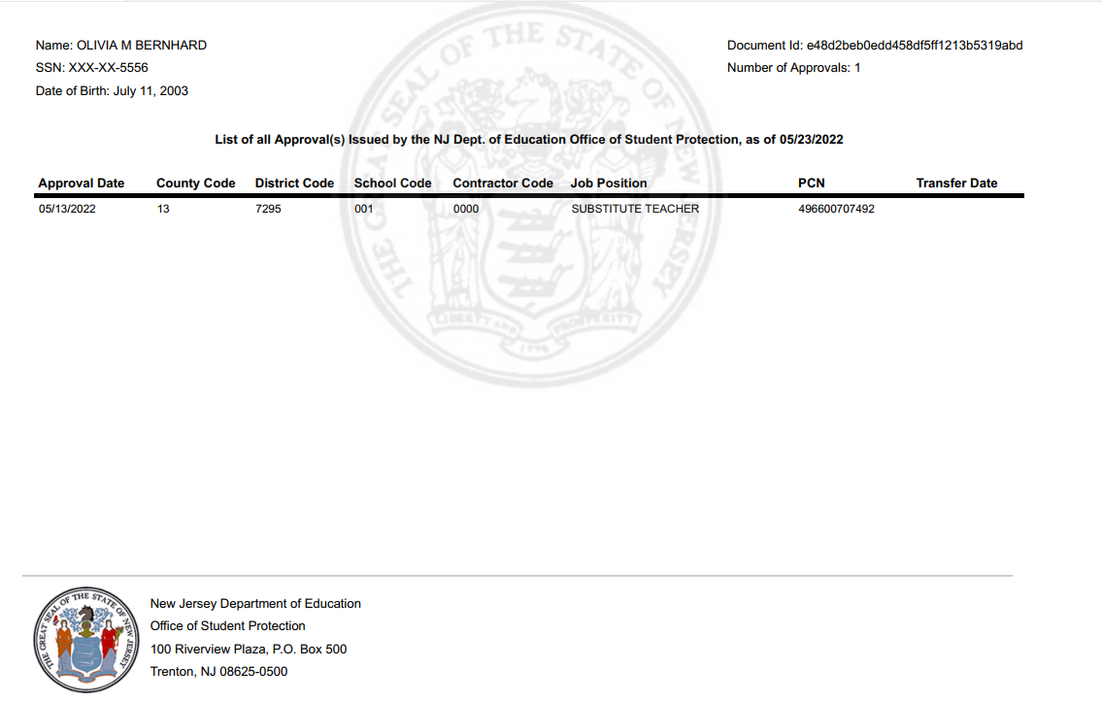
Example Background Sent to Kean University
*Codes for Sending the Background Approval to Kean University*
Job Category: Substitute Teacher (04)
Sponsor: Kean University (397235001)
Notes:
If your approval is there, this is an example of what your background approval form will look like. Do not use any numbers/codes on this example, as this is only an example of what the document will look like. Notice that it has only one line/district approval – the approval for Kean University. In this example, the student is still not eligible to start their placement in district. Why? Because the approval as a substitute teacher is to Kean University. The approval must now be transferred to the district for placement this upcoming semester. Please pause the presentation here and open the “HOW TO TRANSFER YOUR CRIMINAL HISTORY RECORD CHECK AND FINGERPRINTS” training presentation. This was sent to you along with this presentation. This brief transfer presentation is solely instructing you on how to transfer your approval.

Slide 18

Let’s Review
Today: filed for criminal background check and scheduled fingerprinting
Next: Attend fingerprinting appointment
About two weeks after appointment:
Continuously check for approval on Office of Student Protection website https://www.nj.gov/education/crimhist/ ***you will NOT receive confirmation***
Once approved and sent to Kean University, transfer to your district of placement for the semester
Notes:
As a review, prior to starting your first placement you will need to complete a background check as a substitute teacher.
The first step is to fill out your personal information and use the codes for Kean University.
Once this has been completed you will schedule an appointment to get fingerprinted.
Two weeks after fingerprinting, your results will be available for you to access.
Once they are available you have to transfer it to your district.

Slide 19
Questions?
REACH OUT TO OUR OFFICE IF YOU HAVE ANY QUESTIONS
coepo@kean.edu
Remember, this is an ongoing process.
You will have to transfer to new district.
Notes:
Please do not hesitate to contact us if you have any questions about the process. You are also welcome to call or email the office and come in for an appointment to go through these steps.
Thank you for taking the time to view this presentation and for being diligent in completing the requirements necessary for your placement. This is an iterative process for each placement. We appreciate your diligence and attentiveness to completing the transfer prior to each placement.
Kean COE is here to assist you with any placement needs or questions you may have. We look forward to seeing and hearing from you soon.
Cougars Climb Higher!

