Slide 1

Transfer and Archive Process

Slide 2

How To Transfer and Archive Your
Criminal History Record Check
and Fingerprints To Your District
Notes:
In this presentation, we will go over how to transfer and archive your criminal history record approval to your most current district. Different districts may require different options, so please confirm with your district if they want a transfer or an archive of your criminal history record check. You must do this each semester of placement! Remember to pause the training at any time to allow for completion of processes or to simply take a minute to process the information.

Slide 3
Transfer vs. Archive
A transfer sends the criminal record check to another district.
An archive will run a new background check with the fingerprints on file. Some districts will require the archive.
Be sure to check with your district if they require a transfer or if an archive is required. There is a difference in fee, with the transfer being $6 and the archive fee being $29.75.
Notes:
A transfer sends the criminal record check to another district. An archive actually runs a new background check with the fingerprints on file with the office. Some districts will require an archive.
Be sure to check with your district if they require a transfer, or an archive is required. There is a difference in fee, with the transfer being $6 and the archive fee being $29.75.
Now let’s go through the steps of each process. Be sure to pause the presentation at any time you need to take notes or review.

Slide 4
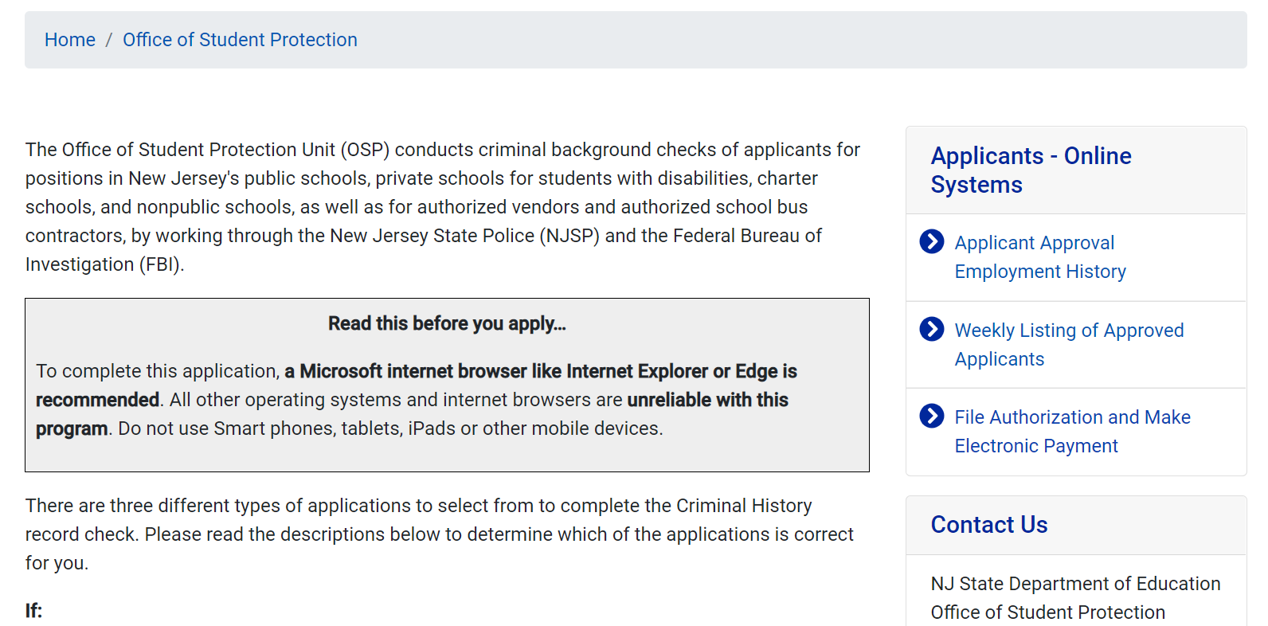
Click “File Authorization and Make Electronic Payment.”
https://nj.gov/education/crimhist/
Transfer Process
Notes:
If you are reviewing this presentation, you have completed your criminal history record check, put a two week reminder on your calendar, have accessed your approval, have informed Kean’s Office of Student Placement and Clinical Experiences that your Criminal History Approval to Kean University has come in and you are ready to transfer your approval to your placement district. You will need to go back to the Office of Student Protection website using https://nj.gov/education/crimhist/. Here you will select "File authorization and make electronic payment" on the right hand side. The third option in the list. Pause the presentation here if you need to gather your payment method.

Slide 5
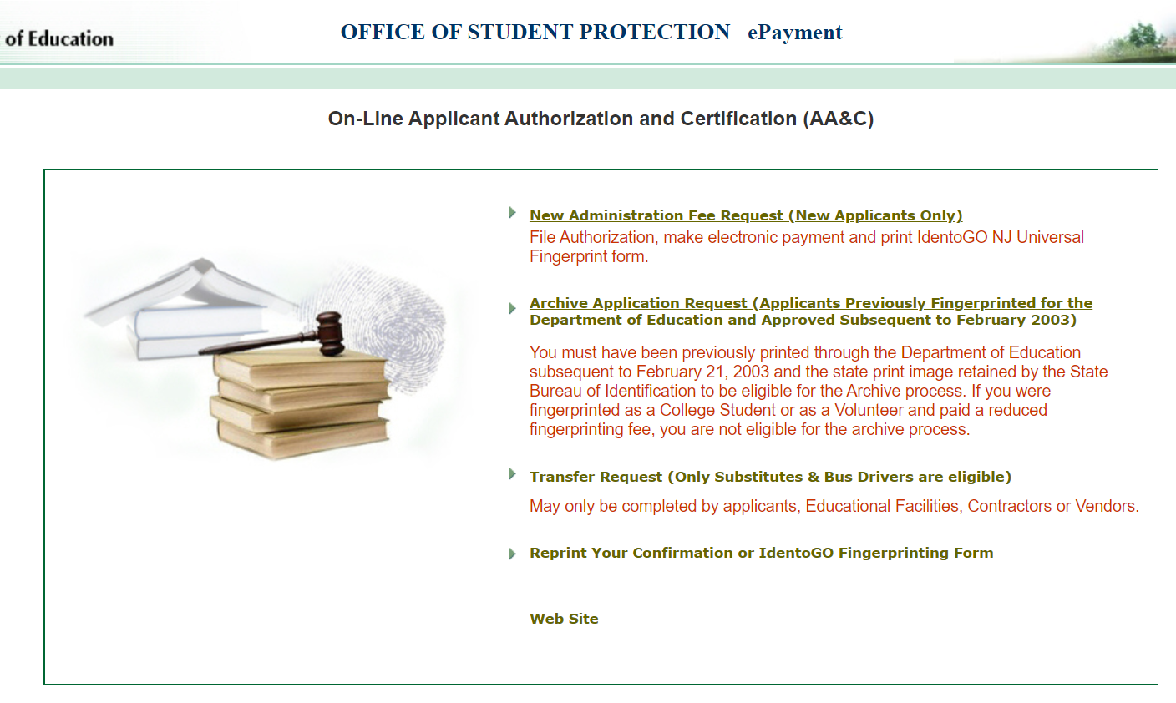
Click on Transfer Request
Notes:
After doing so, you will see this screen. Here you will select "transfer request". Some districts may require you to Archive the request to them. The difference between archiving and transferring is that another background check is completed before transferring the approval to the new district. As the site indicates, you do not need to go for another fingerprint appointment, the archiving process allows the state to use your prints on file and perform an updated review of your criminal history. It costs a bit more and take a bit longer. You only need to archive your approval if the district requests it. For our purposes, we will go through the transfer process, which is the more common requirement.

Slide 6
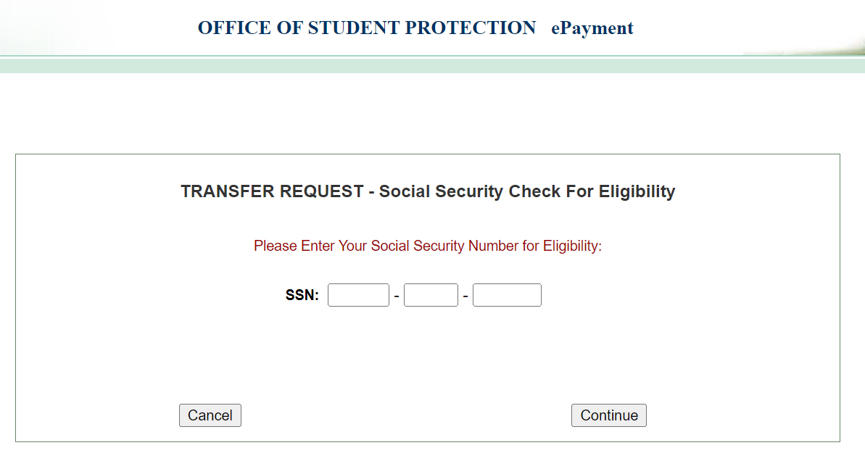
Enter your SSN
Notes:
After selecting transfer request, you will be prompted to enter your SSN. This is one place you may run into issues if you entered your SSN incorrectly when initially completing your criminal history record check. If that's the case, you will need to contact the Office of Student Protection. If not, you will see a screen that offers two options.

Slide 7
Completing the Transfer
You will see 2 options (Bus drivers OR All other Positions)
Complete the requested applicant information
Review information and complete payment ($6 to Transfer)
When payment has gone through you will see: “Your ePayment transaction has been processed successfully.” You should print a copy of this receipt for your records
Notes:
You will be presented with 2 options: bus drivers or all other positions. You will want to select "all other positions." After selecting this, you will complete the requested information.
Please be sure that this is accurate and that you are sending it to your school. Some districts have very similar names so be sure to verify which one you will be in. Please make sure to enter all of the correct county, district and school information. Again, pause this presentation to complete the steps necessary.
After entering your information, you will have to review your information and complete payment, which is $6 to transfer. Be sure to save a copy of your receipt when transferring.

Slide 8
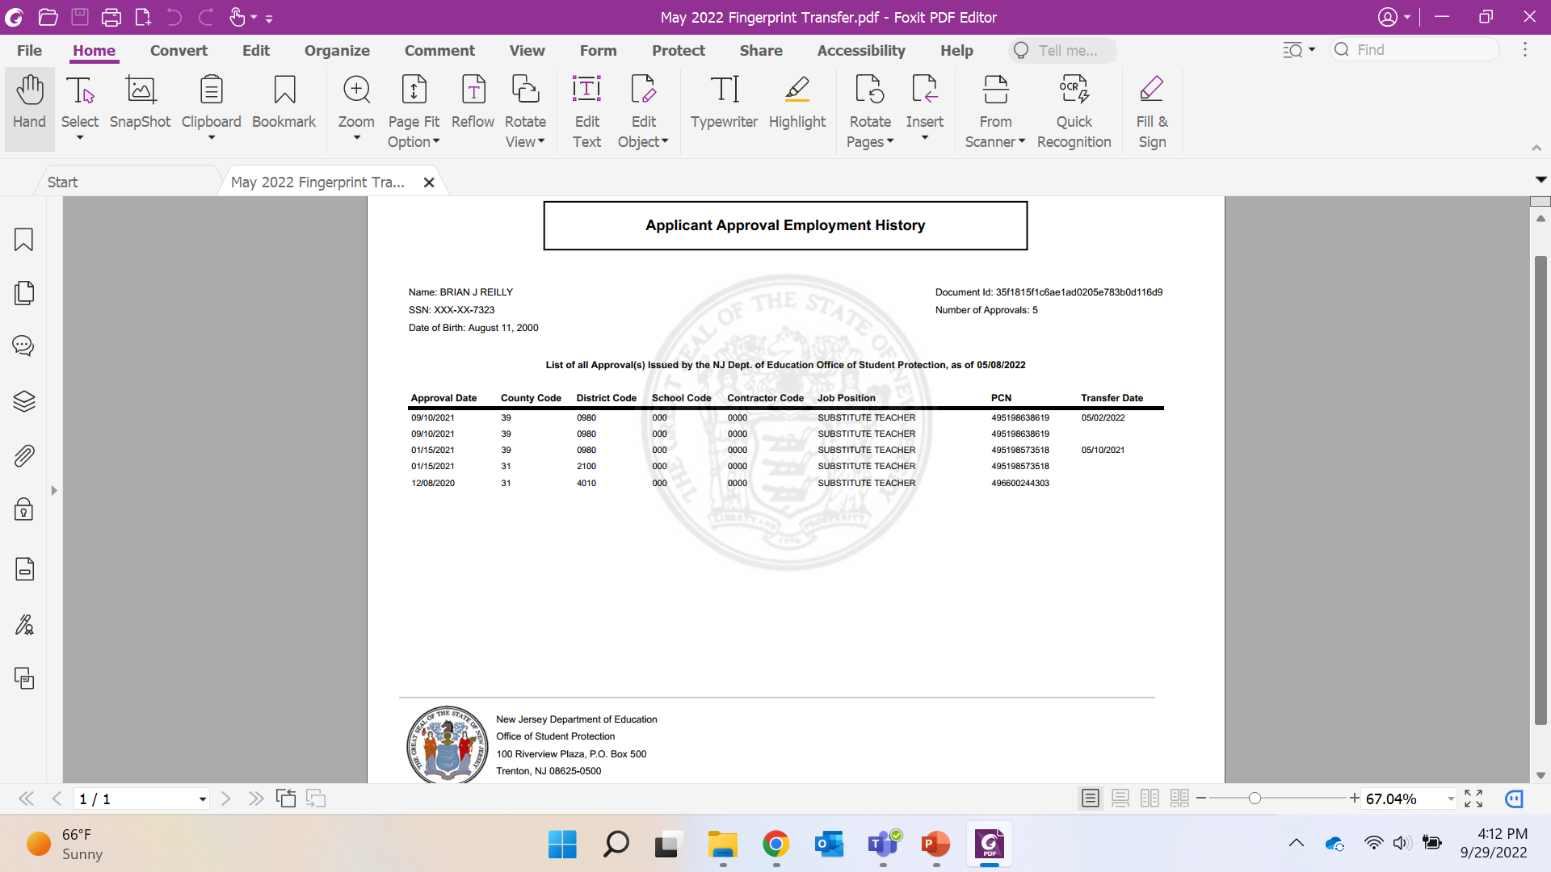
You must transfer or archive your
background check for each placement!!
Each new placement will need to have a transfer/archive. For each transfer you will have a new line on your form.
Notes:
This is an example of an approval for a student near the end of their program or a graduating senior. Notice how they have multiple lines from transferring to each new district they were placed in.

Slide 9
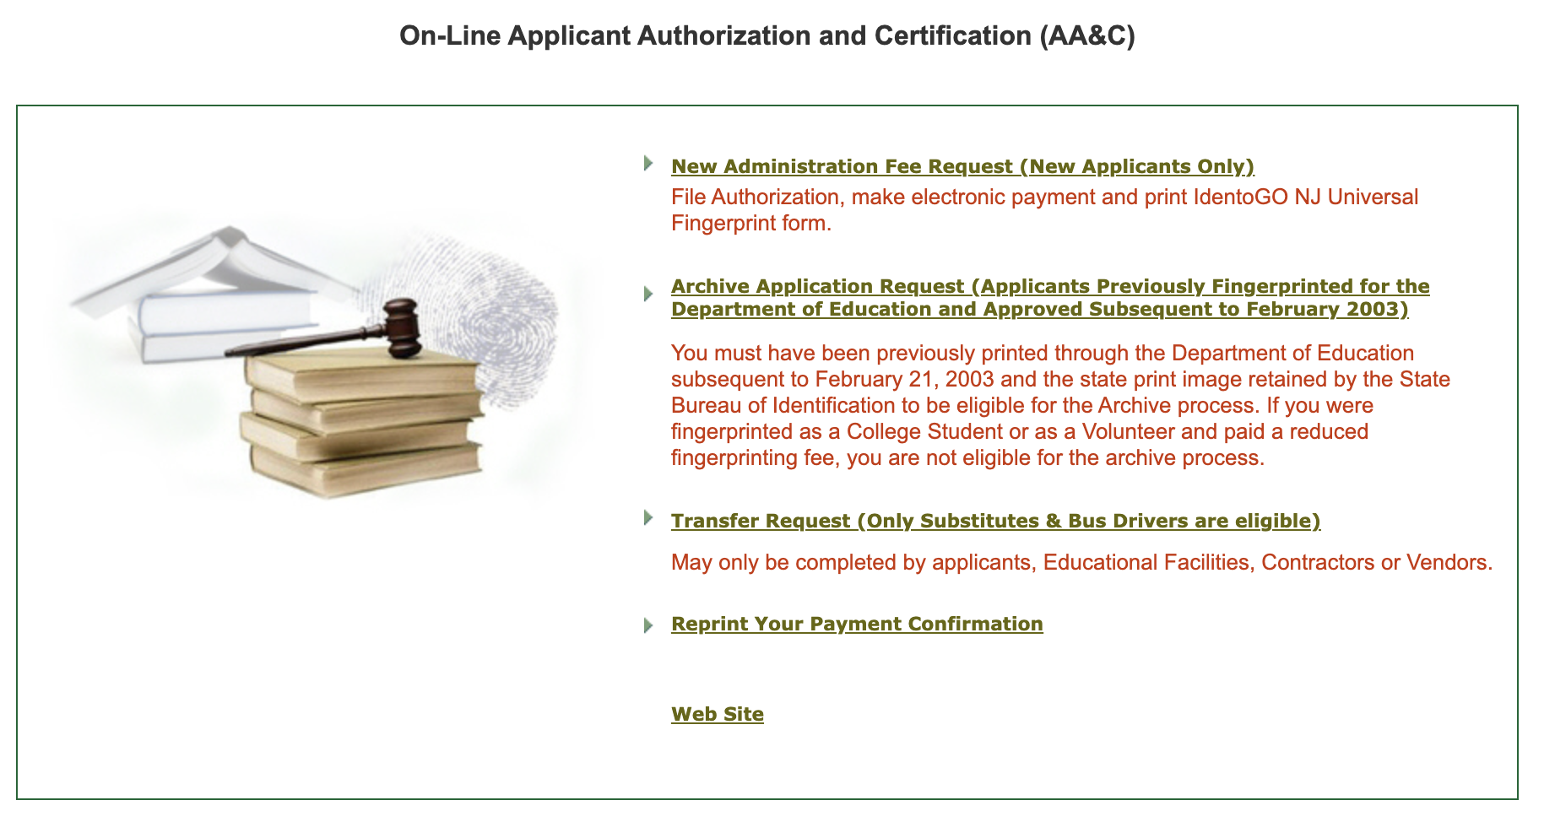
Archive Process
Please go to https://www.nj.gov/education/crimhist/archive.shtml Select the second option: "Archive Application Request (Applicants Previously Fingerprinted for the Department of Education and Approved Subsequent to February 2003)."
Notes:
Now let’s look at the archive process. You can begin this process at https://www.nj.gov/education/crimhist/archive.shtml When you come to the page shown here in the screen shot, please click the second option, which is pointed to by the blue arrow.

Slide 10
Enter your SSN
Notes:
After selecting archive application request, you will be prompted to enter your SSN. This is one place you may run into issues if you entered your SSN incorrectly when initially completing your criminal history record check. If that's the case, you will need to contact the Office of Student Protection. If not, you will come to the Applicant Authorization and Certification Form page.

Slide 11
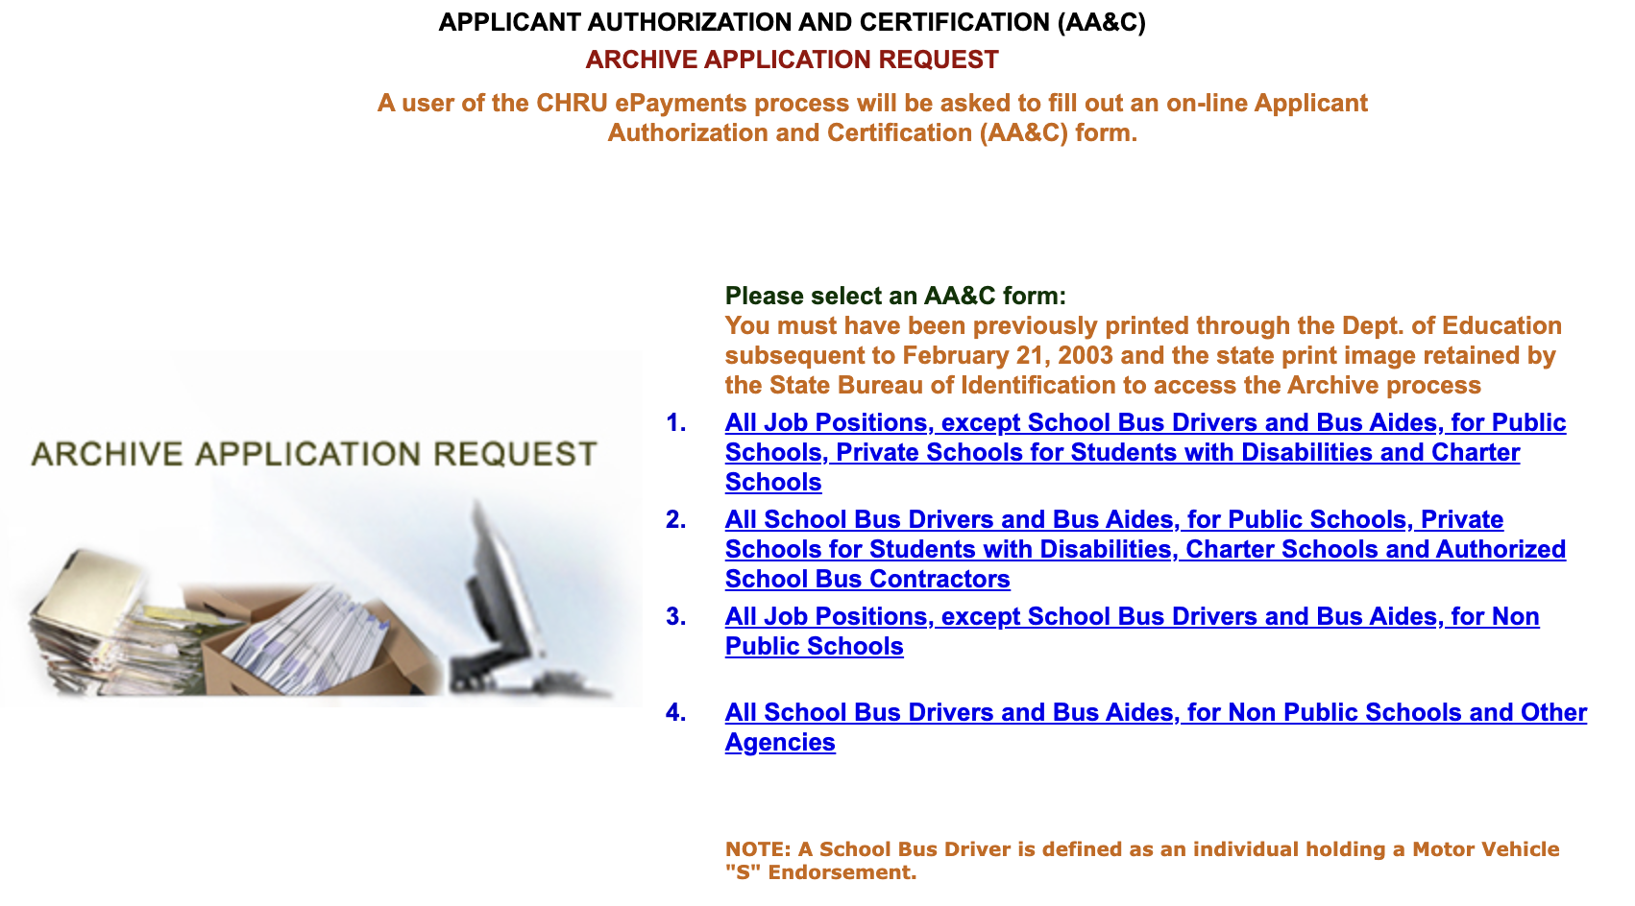
Select the first option: “All job positions, except school bus drivers and bus aids, for public schools, private schools for students with disabilities and charter schools.”
Select the appropriate Applicant Authorization and Certification Form
Notes:
When on the “Applicant Authorization and Certification Form” page seen here, please select the first option which is pointed to by the blue arrow. Again, as you work your way through the process, please stop the presentation at any time to collect your thoughts or payment method.

Slide 12
Completing the Archive
Complete the requested applicant information and then Click "Next."
Submit your credit card payment. ($29.75 fee)
When payment has gone through you will see: “Your ePayment transaction has been processed successfully.” You should print a copy of this receipt for your records
In about two weeks, you will be able to view and print your "Applicant Approval Employment History" by accessing it on the Office of Student Protection website.
Notes:
After selecting this, you will complete the requested information. Please be sure that this is accurate and that you are sending it to your school. Some districts have very similar names so be sure to verify which one you will be in. Please make sure to enter all of the correct county, district and school information. Again, pause this presentation to complete the steps necessary. After entering your information, you will have to review your information and complete payment, which is $29.75 to archive. Be sure to save a copy of your receipt when transferring.

Slide 13
Questions?
REACH OUT TO OUR OFFICE
IF YOU HAVE ANY QUESTIONS
coepo@kean.edu
Remember, this is an ongoing process.
You will have to transfer/archive to each new district.
Notes:
Please do not hesitate to contact us if you have any questions about either of these processes. Thank you for taking the time to view this presentation and for being diligent in completing the requirements necessary for your placement. This is an iterative process for each placement. We appreciate your diligence and attentiveness to completing the transfer prior to each placement.

