Slide 1
Next Four Years at Kean
• Office of Financial Aid and Scholarship Services • • Office of the Registrar • Office of Student Accounting •

Slide 2
Office of Financial Aid and Scholarship Services

Slide 3
Useful Tips & Reminders from Financial Aid
Log into Financial Aid Self-Service to check your financial aid package often
Be familiar with your scholarship requirements to ensure you can keep reoccurring offers
Before changing your program or adding/dropping credit be sure to check to if there is any impact on your financial aid
Apply for Kean Foundation Scholarships - Application is open October 1 - March 1

Slide 4
How to maintain financial aid for all four years?
File your FAFSA every year, remember October 1
Maintain Satisfactory Academic Progress (SAP)
GPA: Cumulative undergraduate GPA meets a minimum of 2.0
PACE: The rate at which you are progressing through your program of study key is to maintain 66.67%
OCT
1
File your FAFSA every year beginning October 1
2.000+
GPA
66.67%
PACE

Slide 5
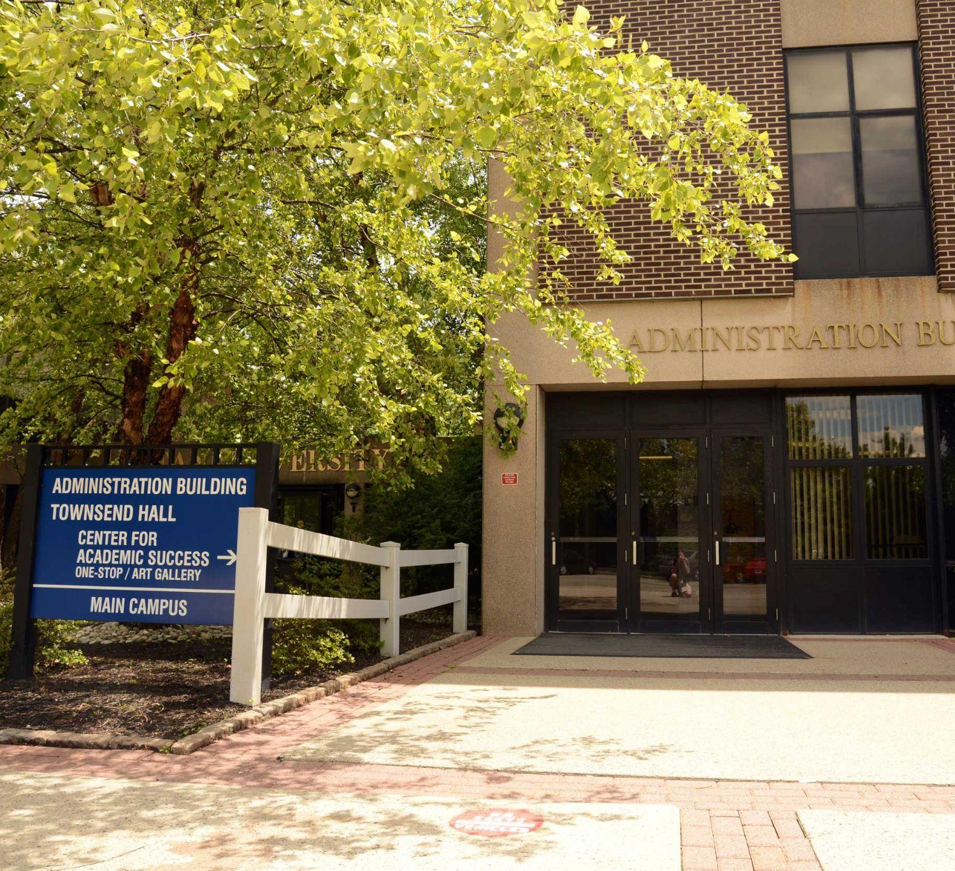
Contact Financial Aid
Office of Financial Aid and Scholarship Services
Administration Building, 1st Floor
(908) 737-3190
Financial Aid: finaid@kean.edu
Scholarship Services: KUScholar@kean.edu
Schedule an appointment online to meet with a Financial Aid Counselor.

Slide 6
Office of the Registrar

Slide 7
Family Educational Rights and Privacy Act (FERPA)
The Family Educational Rights and Privacy Act (FERPA) grants students certain rights, privileges, and protections relative to individually identifiable student education rec­ords maintained by Kean University.
A person becomes a student when they arrive to their first class of the semester in which the person first enrolls.
If the person is fully matriculated or is at least 18 years of age by the first day of the student’s first semester, then the privacy rights belong to the student
Do parents have access rights to their student’s educational records?
Yes, but only under certain circumstances:
If student is claimed as a dependent for Federal income tax purposes (documentation required).
If the student is willing to release information (Student Educational Records Release form must be completed by the student in KeanWISE).

Slide 8
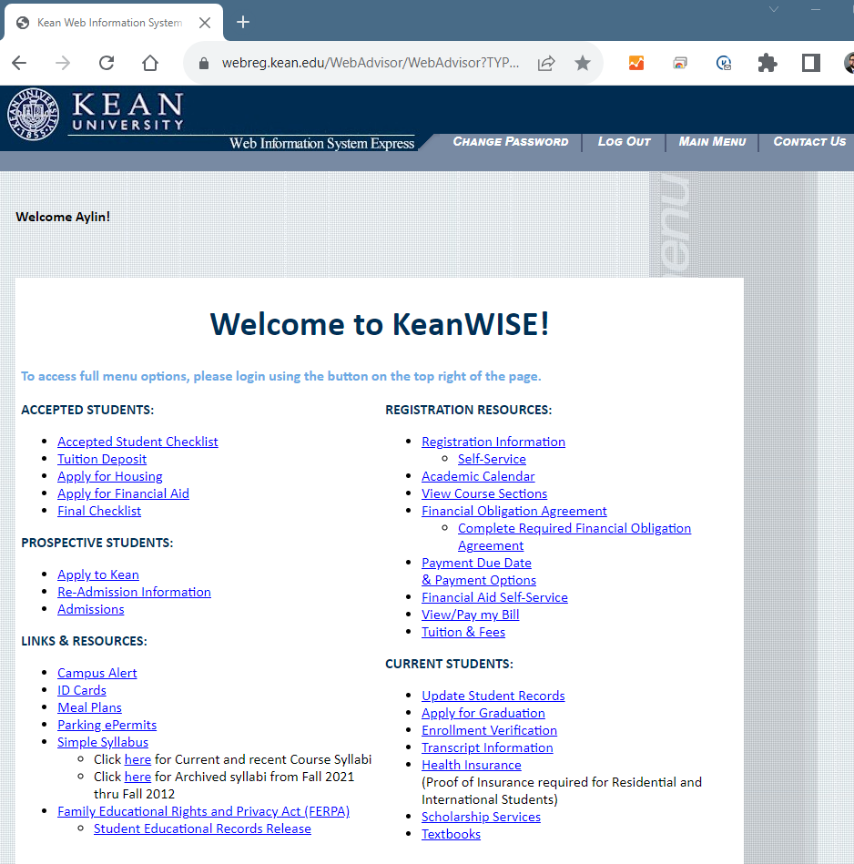
KeanWISE
KeanWISE is your student portal. Use KeanWISE for:
Registering for classes (and making changes until the end of add/drop)
Viewing your course schedule
Viewing your unofficial transcript
Address and phone number changes
Applying for graduation
Viewing your academic plan
FERPA Student Educational Records Release
Viewing/paying your bill
Accessing Financial Aid Self-Service
Accessing the Residence Life Housing Portal
kean.edu/keanwise

Slide 9
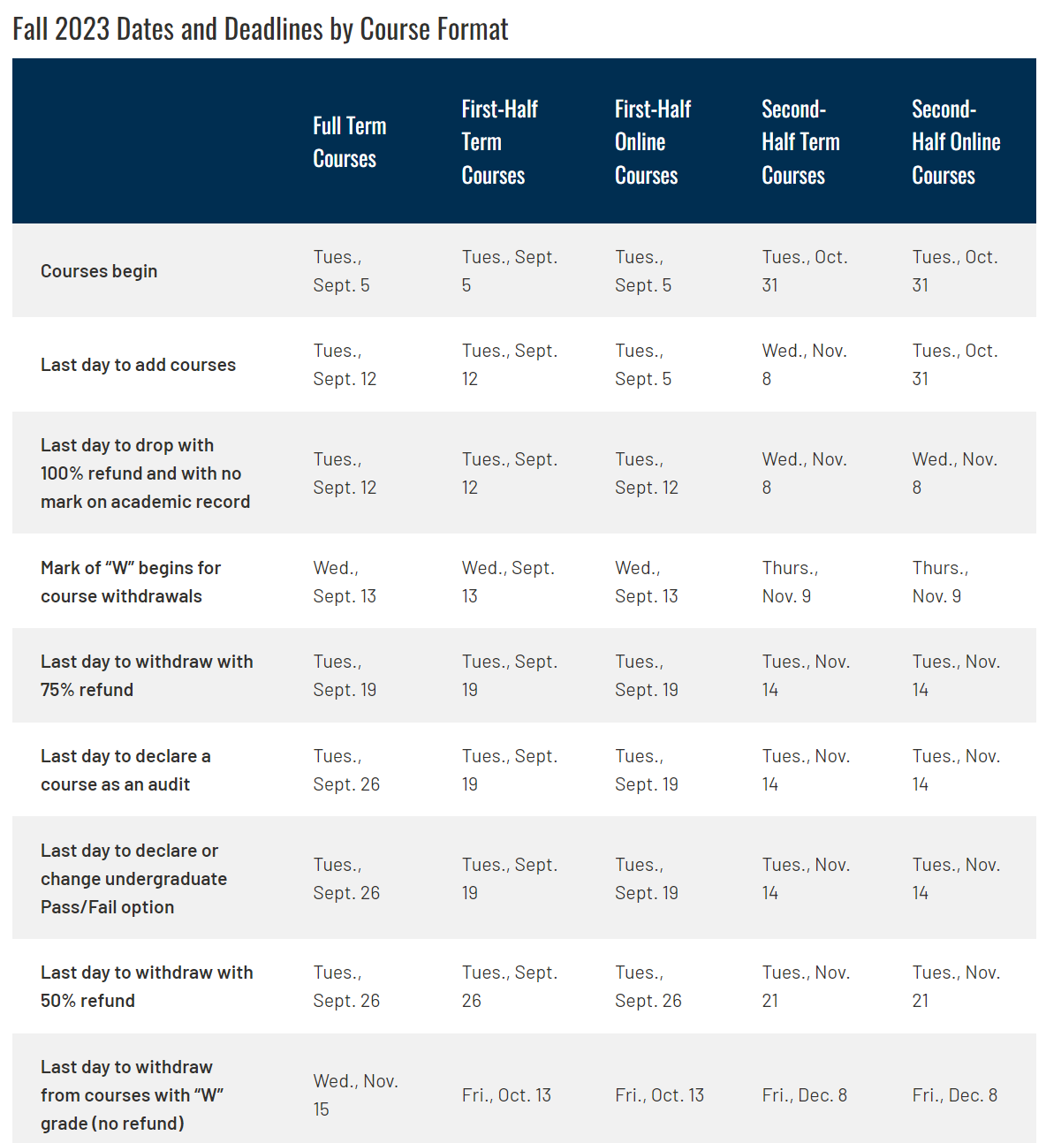
Academic Calendar
Available online at kean.edu/academic-calendar.
Provides important dates and deadlines for each academic semester, including:
Class start and end dates
Withdrawal deadlines
Refund deadlines
Holidays
SEPT
5
First Day of Fall 2023
SEPT
12
Last Day to Add Courses
Last Day to Drop Courses (100% Refund)

Slide 10
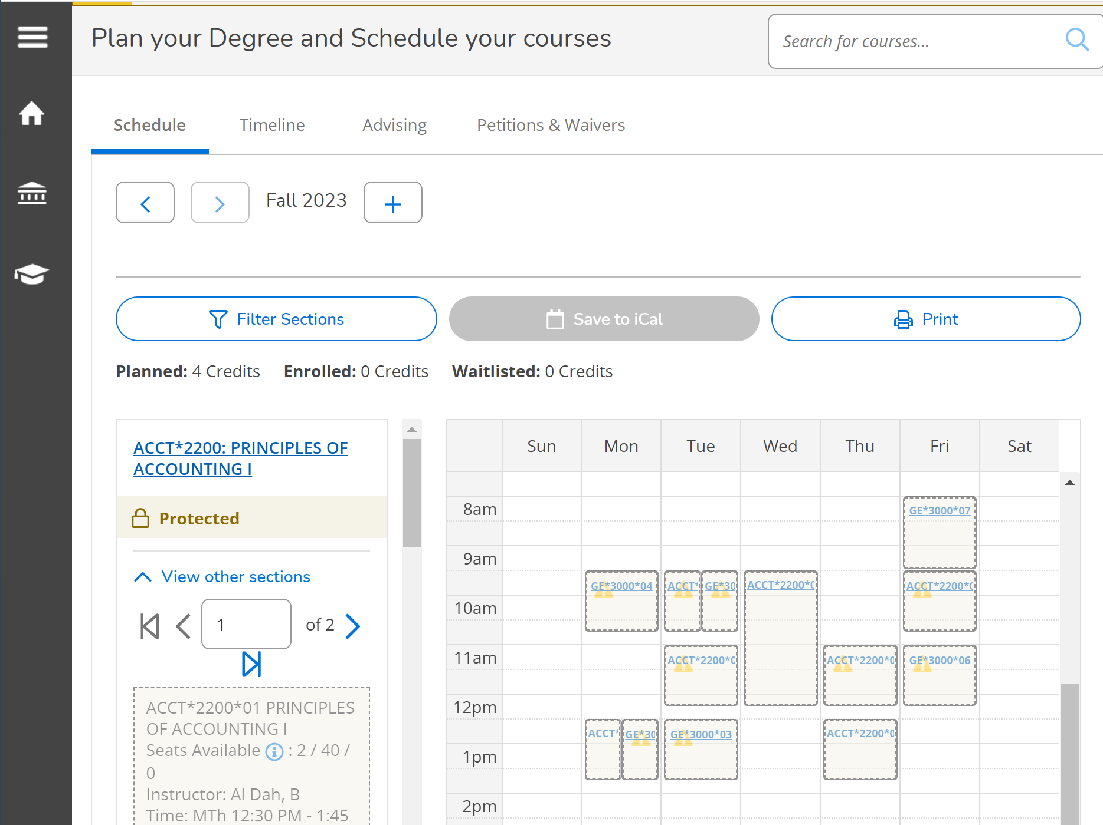
Registration
Registration takes place online in KeanWISE.
Two registration cycles:
Summer and Fall semesters
Begins late-March/early April
Winter and Spring semesters
Begins late-Oct./early-Nov.
All students should seek academic advisement and must resolve any outstanding holds prior to registering.
kean.edu/register

Slide 11
Grades, Honors and Transcripts
Course grades are viewable in KeanWISE upon submission from the course instructor
Instructors should submit final grades within four business days after the course has ended
Dean’s List recognizes students with high academic achievement each term.
Requires 3.45 cumulative GPA for the semester or better
Final cumulative grade point average upon graduation can earn honors distinction:
Summa cum laude: 3.85-4.00
Magna cum laude: 3.65-3.84
Cum laude: 3.45-3.64
Unofficial transcripts can be accessed 24/7 in KeanWISE.
Students needing official transcripts may request them online either electronically or paper ($10 fee required)

Slide 12
One Stop Service Center
Contact One Stop for assistance with:
Registering for classes
Withdrawing from a course
Understanding and resolving account holds
Changing/declaring majors and minors
Changing addresses
Enrollment verification
Navigating KeanWISE
CONTACT ONE STOP
(908) 737-3463
regme@kean.edu
Center for Academic Success, 1st Floor
Summer Hours:
M-Th: 9:30am-5:30pm

Slide 13
Office of Student Accounting

Slide 14
The Office of Student Accounting
Financial Obligations
Due Date Information
Payment Plans
Meal Plans
The Student Account Suite

Slide 15
Financial Obligation Agreement
Students Registering for any term will be required to click and agree to the Financial Obligations AGreement (FOA) on KeanWISE, once per term, before being allowed to register.

Slide 16
What Does It Mean To Fulfill My Financial Obligations?
1. Make payment in full out-of-pocket by the due date.
2. Have enough financial aid awards to cover charges in full by the due
date (Grants/Loans/Scholarships).
3. Set up a payment plan by the due date.
4. A combination of the above.

Slide 17
Due Date Information
August 2, 2023
Late Registration Fee:
Students registering after the payment due date will be assessed a late registration fee of $105.00
Late fees may be assessed if financial obligations are not satisfied.

Slide 18
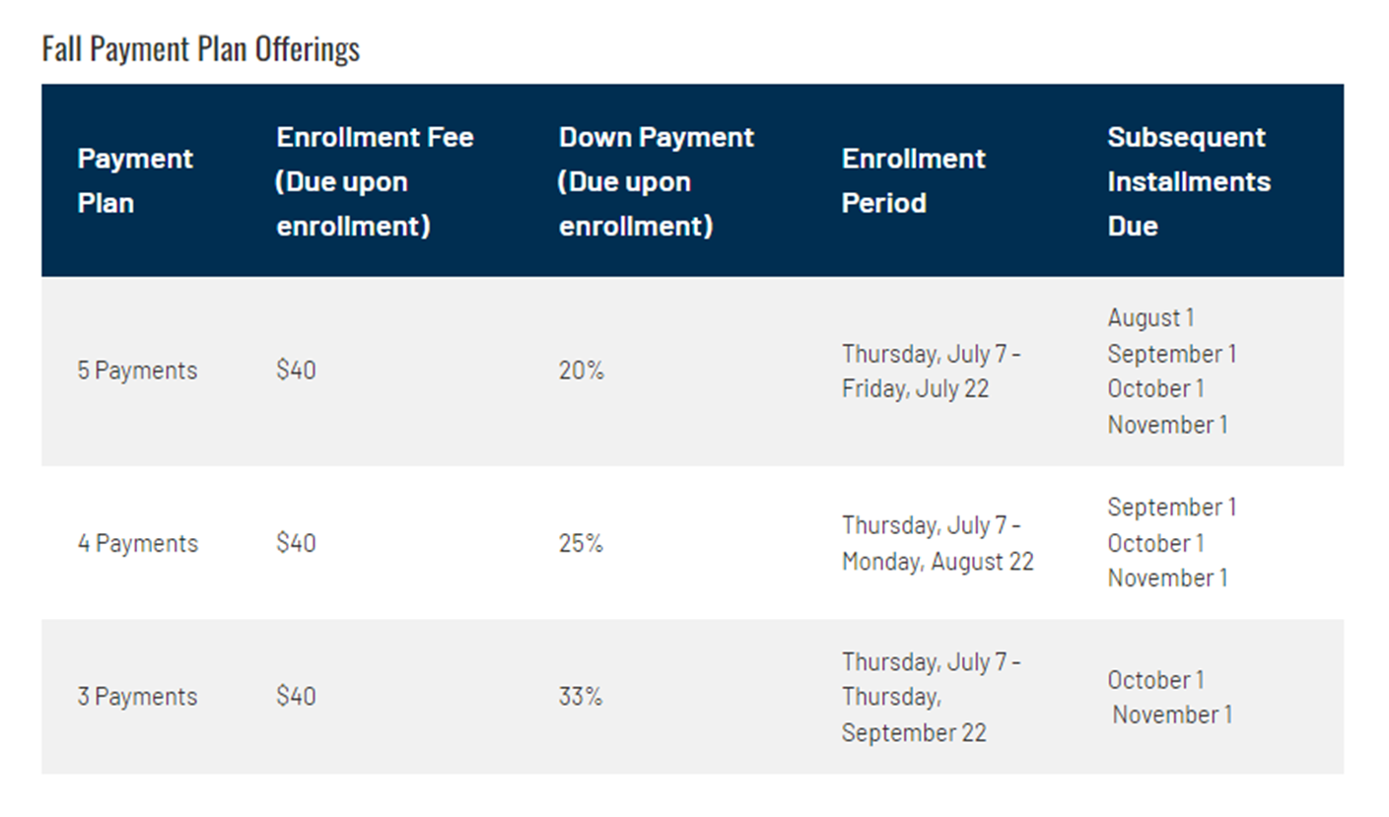
Payment Plans

Slide 19
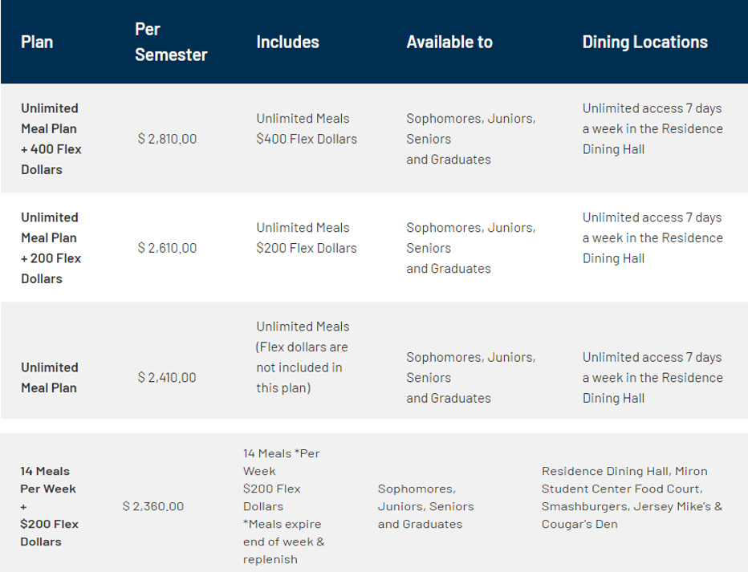
Meal Plans

Slide 20
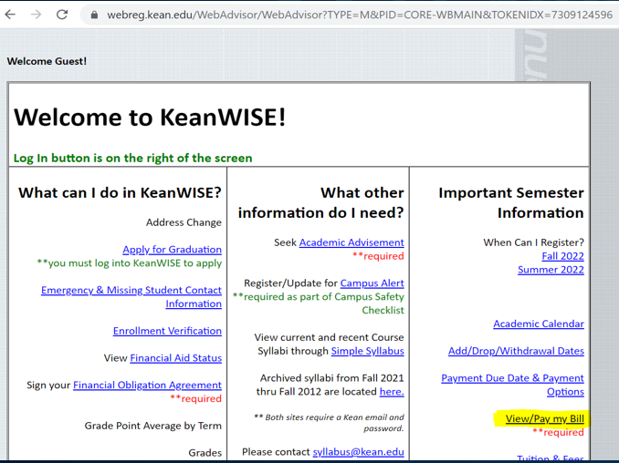
The Student Account Suite
Log into KeanWISE and click on View/Pay My Bill.

Slide 21
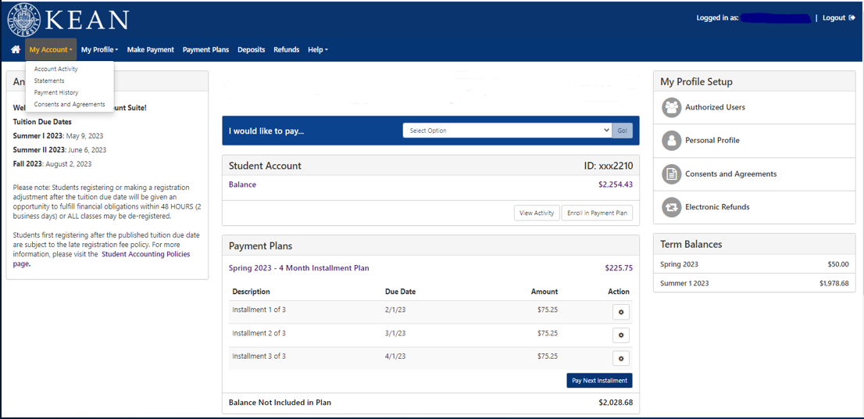
The Student Account Suite

Slide 22
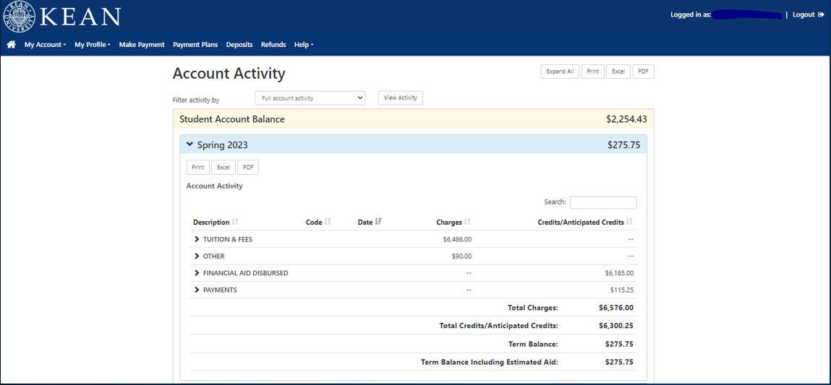
The Student Account Suite

Slide 23
The Office of Student Accounting
Kean University
Office of Student Accounting
Administration Building, 3rd Floor
Union, NJ 07083
P: 908-737-3240
F: 908-737-3250
www.kean.edu/offices/student- accounting
stuactg@kean.edu
for general inquiries & questions.
billing@kean.edu
for billing related inquiries & questions.
disputemybill@kean.edu
for any fee disputes.

Slide 24
Questions?

